Slide 1
Educational Audiology in Schools: Foundations, Complex Cases, and Practical Strategies
Annette Hurley, Ph.D., CCC-A
Louisiana State University Health Sciences Center

Slide 2

Financial Disclosure/ Conflict of Interest
Dr. Hurley is Department Head/Audiology Program Director/Associate Professor at LSU Health Sciences Center in New Orleans, LA. The LSUHSC Foundation is receiving an honorarium for this presentation. There are no conflicts of interest to report.

Slide 3
Learner Outcomes
By the end of this workshop, participants will be able to:
1. Identify types and degrees of pediatric hearing loss and their impact on learning.
2. Recommend classroom support, including technology and environmental modifications.
3. Describe comorbidities and barriers to hearing services.
4. Apply strategies for supporting children with ASD and hearing loss.
5. Recognize the implications of CVI for auditory learning.
6. Collaborate effectively to support children with hearing needs.

Slide 4
Overview
Any hearing loss can adversely affect learning.
Hearing ability is critical to speech and language development, communication and learning.
This session will bring together several topics:
  including, statistics of hearing loss in the classroom,
  unilateral, or single-sided deafness,
  a mild loss is not inconsequential,
  severe to profound loss.
We will also review psychosocial aspects of children with hearing impairment and technologies available to help students with hearing impairment including remote microphone technology and captioning.

Slide 5
Why is this important?
Gain an understanding of support and management practices of students with any hearing loss
Discuss academic achievement and psychosocial effects of hearing loss in adolescents
Discuss the use of captioning in the classroom.

Slide 6


How important is hearing in the classroom?

Slide 7
Listening Vs Hearing

Slide 8
Hearing Vs Understanding
There is a difference between hearing and listening.
Hearing is passive/occurs
  Sound- physical movement of air molecules
Listening-Active- interpreting meaning from the acoustic waveform
Can we improve listening/audibility/Hearing?
Audibility – speech can be heard, but not clearly enough to understand what is said
Intelligibility – Speech is heard clearly enough to hear fine distinctions
  /chew/ vs /shoe/

Slide 9
Listening vs Hearing
Hearing is passive, occurring continuously during every minute of the day.
In contrast, listening is an active process, requiring us to:
  first pay attention
  then process selected auditory stimuli
  all while ignoring other auditory information
    Noise
    Competing signals
  But, in order to listen, we must first be able to hear.

Slide 10
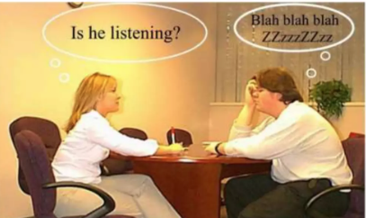
Listening
Humans have 2 organs to listening and just one to speak so, Listening is 2 more difficult than speaking.
Listening is a step further than hearing, where the brain receives the nerve impulses and deciphers it, it then sends feedback.
Listening is the process of becoming aware of the sound signals entered through the ear and modified by the nervous system
Listening requires concentration, deriving meaning from the sound and reacting to it.
Listening is a process of communication, where if the person is not listening, it can cause a break in communication.

Slide 11
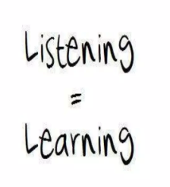
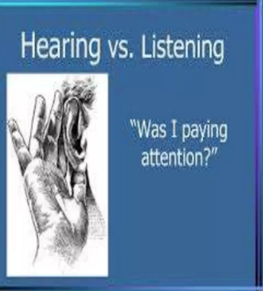
Active Listening
Active listening is a technique used in communication which requires a person to pay attention to the speaker and provide feedback.
Systematic process
  Input
  Processing
  Output

Slide 12
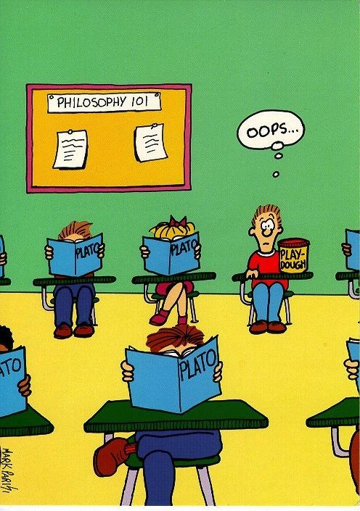
Breakdown
A student was searching the library for a required reading Oranges and Peaches. To his dismay he learned the book was Origin of Species by Darwin.

Slide 13
Listening Effort:
"the deliberate allocation of mental resources to overcome obstacles in goal pursuit when carrying out a task, with listening effort applying more specifically when tasks involve listening" (Pichora-Fuller et al. 2016, page 5S)
attention and cognitive resources required to understand speech’ (Hicks & Tharpe, ; Anderson Gosselin & Gagné, ; Fraser et al, ; Picou et al,)

Slide 14
Understanding Speech requires
Cognitive Processing
When listeners hear speech they must match the rapid incoming acoustic stream to stored representations of words and phonemes to successfully extract the intended meaning.
The process of correctly identifying sounds is made more difficult when speech is acoustically degraded: less information is available to the listener, which reduces the quality of speech cues and thus increases the chance for error.

Slide 15
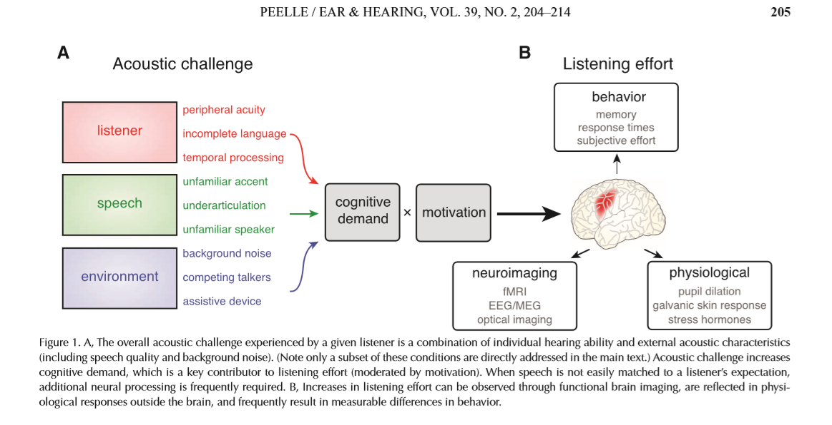

Slide 16
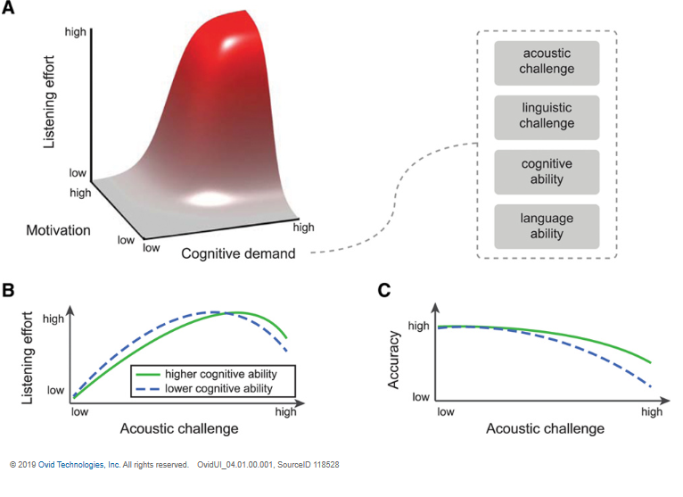

Slide 17
What happens when the signal is degraded?
Behavioral Evidence:
Hearing impairment? (Filtering the incoming signal)
  Less accurate
  Make take longer to respond
  May affect memory (Hearing impaired individuals show poorer performance for short stories when compared to normal hearing individuals.) This improved listeners were allowed to slow the rate of the story.

Slide 18
What happens when the signal is degraded?
Physiological Evidence:
Pupil diameter increases as a function of cognitive demand (Kahneman & Beatty, 1966)
  “Common measures of pupil response include dilation amplitude, peak latency, and mean pupil dilation, which may reflect different physiological responses. Variants of linear mixed effects analysis using flexible basis sets have also seen increasing use in analysis of pupillometric data (Mirman 2014)”
Neuroimaging Evidence:
  fMRI: increased activity in regions
  EEG
Cardiac Response
Skin Conductance Response
Hormonal Response
Peele, J.E. Listening Effort: How the Cognitive Consequences of Acoustic Challenge Are Reflected in Brain and Behavior 39(2), March/April 2018, p 204-214

Slide 19
Self-Reported Scales
Participants give a response on a scale of 0 to 10 with lower numbers indicating more difficulty or effort.
  Do you have to concentrate very much when listening to someone or something?’;
  ‘Can you easily ignore other sounds when trying to listen to something?’;
  ‘Do you have to put in a lot of effort to hear what is being said in conversation with others?’ (Gatehouse & Noble2004) https://www.ncbi.nlm.nih.gov/pmc/articles/PMC5593096/ ).
Quick/ Easy to Administer
Provide insight into how effortful speech processing is experienced by the individual
Subjective
  Task difficulty vs mental exertion

Slide 20
Clinically what is the point?
Cognitive processing plays a role in understanding speech in listeners with hearing impairment.
There are individual differences in speech understanding that cannot be characterized by pure tone audiometry or other auditory processing or psychoacoustic testing.

Slide 21
Clinically what is the point?
Could the information be used for counselling the patient?
Neuroplasticity- can we improve with intervention? Hearing aid comparisions

Slide 22

You’re an avid sports fan who is invited to a small dinner party. Guests are engaged in a lively discussion of the finer points of modern art. As a person with hearing loss, you strain to keep up with the conversation. The effort is exhausting and soon you’re too tired to follow the discussion and simply ‘tune out.’
Imagine the same scenario, except this time the topic is great moments in sports history. Again, you have to work hard to hear but now you don’t tune out. You’re working hard – and still tired at the end of the evening – but somehow you seem to have the energy to keep up with the conversation.
In each environment, the challenges – a noisy gathering with multiple speakers - are identical. So why are you more exhausted, more quickly in the first listening situation? And what explains your ability to work harder, for a longer time in the second scenario?

Slide 23
Why the change?
Motivation
Demand
Effort
The Framework Understanding Effort for Listening (FUEL) framework presented in the Ear and Hearing article shows that listening effort is coupled both to demanding listening situations and to an individual’s motivation or lack of motivation. It shows that the listening effort individuals chose to put in demanding a listening situation depends on their motivation.
This may also explain why people choose to abandon a social gathering. If it is too demanding or not motivating enough, it might not be worth putting in the extra effort. The opposite might also be true. If a hearing aid can reduce the demands, then the motivation may be enough to stay in the social gathering and to spend that extra effort necessary. This insight may influence the design of new hearing rehabilitation therapies and technologies that will enable hearing-impaired people worldwide to hear better, with less effort and fatigue – even in challenging environments.

Slide 24
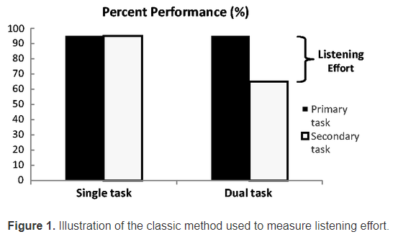
Listening Effort
No standardized test procedure to measure listening effort
  Self-Report
  Behavioral
  Physiologic
Dual task: performs two tasks (speech in noise)

Slide 25
Variables
Age: young vs old
Hearing impairment
Presentation of speech: auditory only, audiovisually (visual cues)
Cognitive ability: memory
Characteristic of the Masker: Speech vs non-speech
SNR
Linguistic Speech signal (Effect greater for low predictability ) Quick SIN
Amplification?

Slide 26
The Auditory System

Slide 27
The Complex Auditory System
The auditory system has more relays to the brain than any other sensory system.
At least six nuclei (sub-stations) where auditory information is further processed or analyzed.
Peripheral system, brainstem, midbrain, auditory cortex.

Slide 28
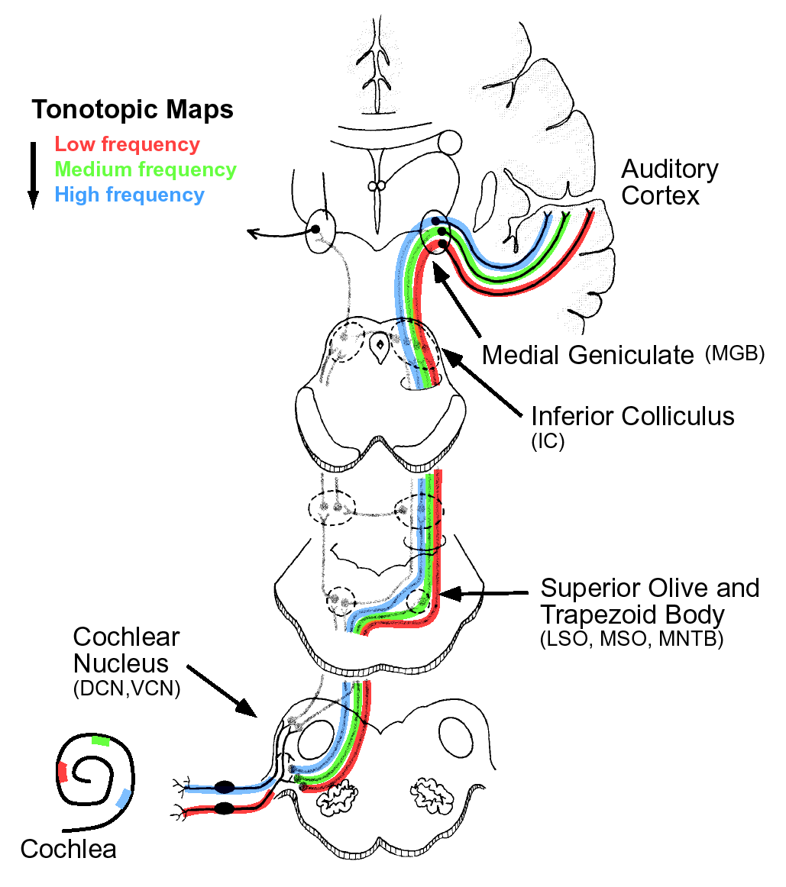
The ascending auditory pathway
Descending pathway roughly parallels ascending pathway
Notes:
Many stages stages of processing – differs from visual system where almost direct input from retina to cortex
Cochlear nucleus
Superior olivary complex
Inferior colliculus (midbrain)
Medial geniculate (thalamus)
Auditory cortex
Tonotopic organization maintained from cochlea to auditory cortex

Slide 29
Sound processing
Extremely complex
  Timing
  Frequency Analysis
Normal Word Production 160 words per minute
10-15 phonemes per second
Auditory system responds faster than visual system

Slide 30
The ‘normal’ developing hearing brain
Development of the cochlear- 24 wks Gestation Age
Development from periphery to the central auditory nervous system
  Brainstem
  Cortex
Myelination: Fatty substance that coats neurons
3 mos: smiling/ recognize voice/ may have different cries
6 mos: localization of sounds, respond to music, recognizes prosody
12 mos: 1st words/understands some words or phrases
Brain maturation continues with some interhemispheric connections not mature until 12+ years (Behavioral and Electrophsyiological)

Slide 31
“Normal” Hearing Child
“If they're never read to, they'll have heard 4,662 words.
If they're read to 1-2 times per week, they'll have heard 63,570 words.
If they're read to 3-5 times per week, they'll have heard 169,520 words.
If they're read to daily, they'll have heard 296,660 words.
And if they're read five books a day, they'll have heard a whopping 1,483,300 words by age five.

Slide 32
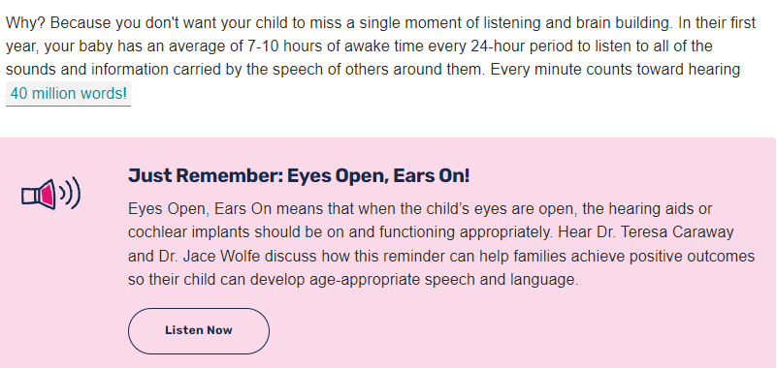
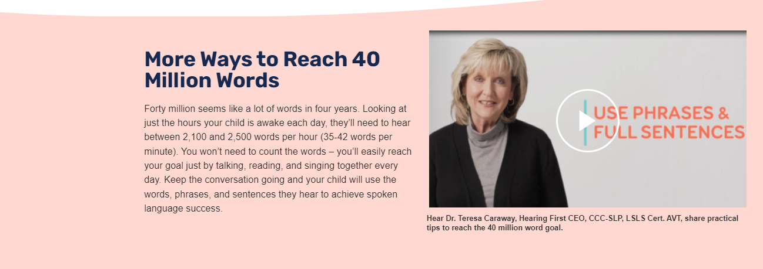

Slide 33
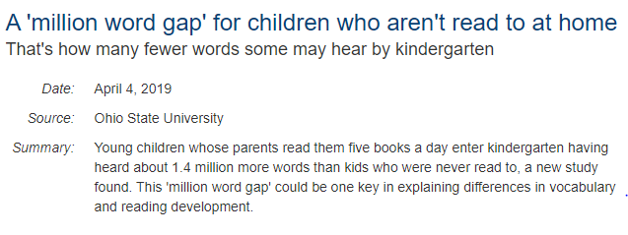
Jessica A. R. Logan, Laura M. Justice, Melike Yumuş, Leydi Johana Chaparro-Moreno. When Children Are Not Read to at Home. Journal of Developmental & Behavioral Pediatrics, 2019; 1 DOI: 10.1097/DBP.0000000000000657

Slide 34

Rich Language Environment

Slide 35
Language Learning through Listening
Children learn what they hear most. Frequency matters.
Interactive and responsive environments build language learning. Children learn in social situations. They learn in social, emotional, connective interactions with people who love them.
Children learn words for things and events that interest them. They learn about words and things that capture their attention.
They learn in meaningful contexts as opposed to those devoid of meaningful engagement.
Vocabulary and grammatical development are reciprocal processes. Do not speak in single words. Speak in phrases or complete sentences.
Children need to hear diverse words and language structures. Don't say the same thing the same way all the time. Use different words and different language structures.
www.roberta-golinoff.com

Slide 36
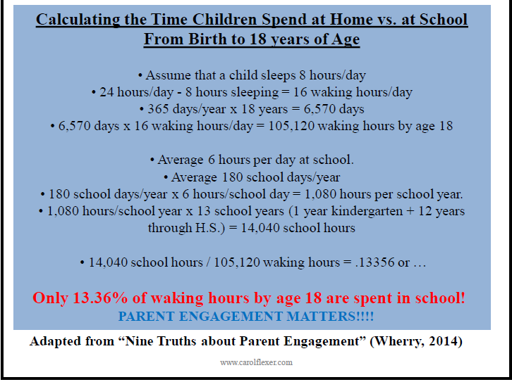
From Carol Flexer, 2018.

Slide 37
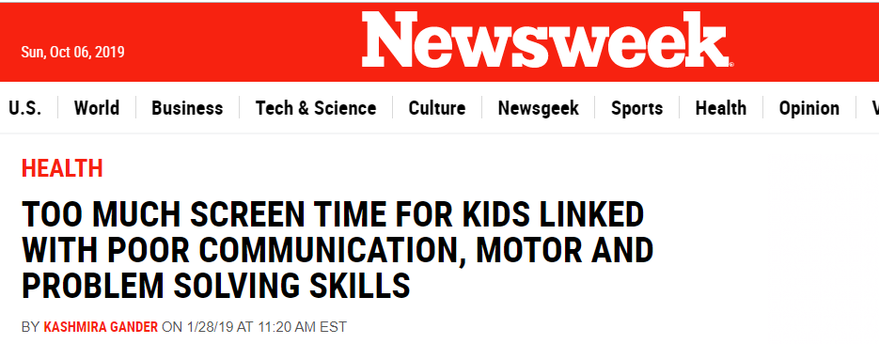
For another lecture on another day

Slide 38
What if a child misses the language rich environment?
Hearing Loss
  Since 1940s researchers have stressed early detection
    Limited by technology
    Immittance?
    ABR
    OAEs
    Automation
Universal Hearing Screening:
  1, 3, 6

Slide 39
The importance of Universal Newborn Hearing Screening
Hearing loss is the most common birth condition
From Grimes, R..A. Update on Newborn Hearing Screening

Slide 40
National Goals for Hearing Screening
(1-3-6)
All infants will access hearing screening using a physiologic measure
  no later than 1 month of age
All infants not passing initial screening and subsequent rescreening should have confirmatory audiological and medical evaluations
  no later than 3 months of age
All infants with confirmed permanent hearing loss should receive early intervention as soon as possible
  no later than 6 months of age
WHAT IS THE FAMILY’S DESIRED OUTCOME?
Notes:
The Healthy People 2010 goals include an objective to “increase the proportion of newborns who are screened for hearing loss by one month, have audiological evaluation by three months, and are enrolled in appropriate intervention services by six months.” ¹ These specific recommendations were expanded and articulated as “principles” in the Joint Committee on Infant Hearing (JCIH) Year 2007 Position Statement.²
The goals listed on slide are frequently referred to as the 1-3-6 plan. These reflect the recommended practices for the timing of screening, diagnostic Pediatric Audiological testing, and referral of diagnosed children to early intervention. The following presentation slides provide justification for these practices along with technical details to support implementation.
Note: The Joint Committee on Infant Hearing was established in late 1969. It comprises representatives from audiology, otolaryngology, pediatrics, and nursing. The Committee publishes recommendations in the form of position statements related to newborn hearing screening and follow up. http://www.jcih.org/
Evidence based references are contained in a Word document on the CD, which can be used as a presentation handout.

Slide 41
Screening Vs Diagnostic Assessment
If a child is “referred” from hearing screening; he should have another hearing screening
If failed hearing screening 2x; must have a diagnostic assessment
Loss to follow-up
Re-screens without a diagnosis
Screening for a moderate to profound hearing loss
  Not Mild/Acquired/Progressive

Slide 42
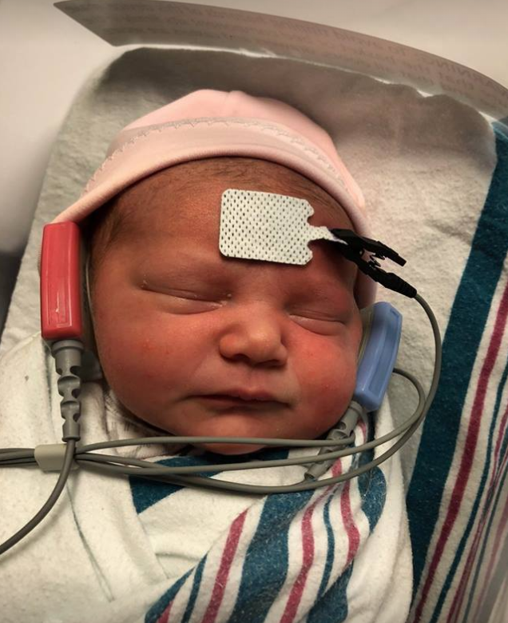
96% of newborns in the U.S. receive hearing screening (NCHAM, 2009)
However, only 46% of those who do not pass are reported as having received follow-up.
  Centers for Disease Control and Prevention (2005). Final summary of 2005 national EHDI data (Version 6). Retrieved from www.cdc.gov/ncbddd/ehdi/documents/Nat_EHDI_Summ_2005_Web_v6.pdf.

Slide 43
Loss to Follow-Up
• Infants are screened in one state who live in another state
• Parent misunderstanding or lack of commitment about the need for follow-up testing following a refer hearing screening outcome
• Physician misunderstanding about the need for follow-up testing following a refer hearing screening outcome
• Information about newborn hearing screening results is not shared with proper persons, including medical home, audiologists, hospitals and/or state EHDI program

Slide 44
Loss to Follow-Up
Inadequate number and geographical distribution of audiologists skilled, experienced, and equipped for diagnosis of and intervention of infant hearing loss
• Parent problems with transportation to diagnostic assessment
• Infants with no primary care physician who are essentially medically homeless
• Infants whose families lack health insurance and who cannot afford diagnostic services
• Parent refusal to consent to the diagnostic evaluation
• The diagnostic assessment cannot be completed due to technical issues that are encountered during the assessment or due to infant non-compliance when ABR testing under sedation is not an option
Diagnostic assessment is not documented.

Slide 45
Why is early identification of hearing loss important?
Hearing loss is the most common birth condition
Previous methods for detecting hearing loss have been ineffective
Undetected hearing loss can delay speech, language, social & academic development
Notes:
Why is early identification of hearing loss important? Left untreated, hearing loss of even mild degrees interferes with speech and language development. In many cases, these delays can be long-term and lead to academic, social-emotional and behavioral consequences. When hearing loss is identified and treated early in life, these negative consequences can be prevented or minimized.

Slide 46
Prevalence of Hearing Loss
Prevalence estimates vary across studies
Estimated that 1 to 3 per 1000 infants will have permanent sensorineural hearing loss
  1/1000 from the well baby nursery
  10/1000 from the NICU
Rate increases to 6/1000 by school age
  Need for surveillance
Notes:
INCIDENCE OF HEARING LOSS: Although estimates vary slightly, prevalence figures for hearing loss in children (from the CDC and NIDCD) indicate that 1 to 3 infants out of every 1000 will have some type or degree of permanent hearing loss. It is expected that 10/1000 infants from the NICU will be identified with hearing loss, whereas 1/1000 are expected from the well baby nursery.
Prevalence rates are expected to increase by school age due to factors such as late onset, progressive hearing loss missed by screening and late identification of hearing loss in children.

Slide 47
Prevalence of HL increases from nursery to school age children
Estimates vary 11-15% of some degree
3.1% of all children and youth
WHY?
  Missed at screening
  Illness after birth
  Lost to follow-up
  Acquired
    Genetic
    Infections
    Exposure to noise
    Environment
    Ototoxic medications
    Errors

Slide 48
Health Barriers that interfere with learning
Vision
Hearing
Uncontrolled asthma
Mental & behavioral problems
Dental pain
Persistent hunger
Effects of lead exposure
20% of children age 6-17 do not receive annual well- child check-ups

Slide 49
Is Hearing Loss a Big Deal?
Young Children
Language
Learning
Literacy
Social Development
Adults
Decreased Quality of Life
Depression
Relationship to Cognitive Decline
  Dementia

Slide 50
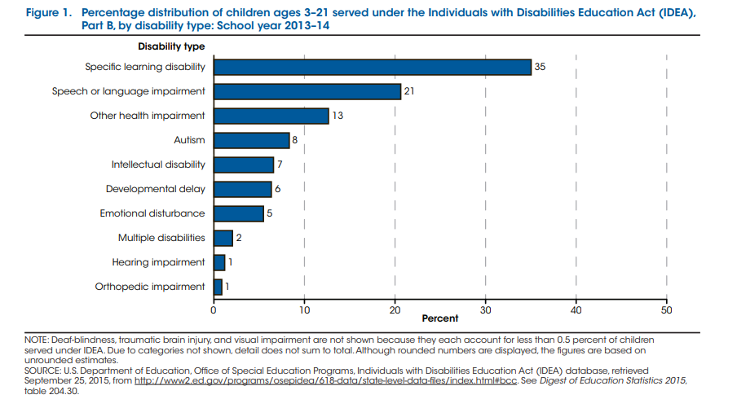

Slide 51
Dx: Assessment
Case History
Pediatric
Confirmation/Diagnostic
  Reason for Referral
  Previous Assessments NHS
  History of Middle Ear Infections
  Developmental Milestones
    Language?
  Family History
  Educational History/Academic History
  Genetic Counseling
  Treatment Plan
    Amplification/CI

Slide 52
Infants and School Age Children
1.03/1000 infants other authors report 2.0/1000 to 6.00/1000 in newborn nursery compared to prevalence of hearing loss in school age children ranging from 5% to 15%. (5 million and 7 million school-age children)
  Progressive
  Late-onset
  Infections
  Illnesses
  Trauma
  Noise
  System misses (technology, screeners, lost to follow- up, etc.)

Slide 53
Diagnostic Assessment
Obtain Threshold Information
  Air & Bone Conduction
  ABR
  Conventional Audiometry
    VRA
    Conditioned Play
  Speech Information
  Immittance Audiometry

Slide 54
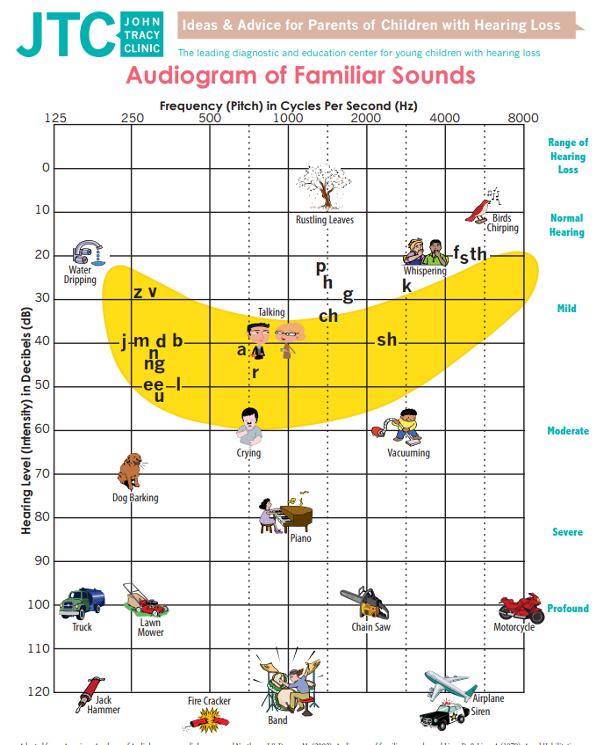
Assessment
Pure tone Audiometry
  Audiogram
  Frequency
  Decibels
  Degree of Loss
  Configuration
Air Conduction: Tests all parts of the ear
Bone Conduction: “by-passes”
outer and middle-ear to measure sensitivity
of inner ear directly

Slide 55
XO
XO
XO
XO
XO

Slide 56
Once Hearing loss is Diagnosed?
Effective Amplification
Any hearing loss is educationally significant!!!!

Slide 57
Types of Hearing Loss

Slide 58
Types of Hearing Loss
Unilateral – one side
Bilateral – two sides

Slide 59
Types of Hearing Loss
Conductive
Sensorineural
Mixed
Auditory Neuropathy/Dysynchrony

Slide 60
Types of Hearing Loss
Conductive
Where does a conductive loss occur?
*Outer ear – from the pinna to the ear drum
Examples: Treacher-Collins syndrome
Atresia
Microtia “little ear”
*Middle ear – from the ear drum to the cochlear
Examples: Downs Syndrome
Ear Infection

Slide 61
Conductive, cont.
outer or middle ear fail to work properly; sounds are “blocked”
may result from the build-up of fluid behind the eardrum or tympanic membrane.
can be caused by the malformation in the outer or middle ear
antibiotics or minor surgery are frequently used as treatment

Slide 62
Types of Hearing Loss
Sensorineural
Where does sensorineural hearing loss occur?
Inner ear – from the cochlea to the VIIIth nerve
Examples: congenital
ototoxic drugs
syndromic
unknown

Slide 63
Sensorineural, cont.
Permanent hearing loss due to damage or trauma to the inner ear or hearing nerve
Cause is often unknown
Severity can range from mild to profound
Hearing aids are used to manage/may be a cochlear implant candidate

Slide 64
Types of Hearing Loss
Mixed
Where does mixed hearing loss occur?
Outer or Middle AND Inner ear – in two or more
different parts of the ear concurrently – from the
pinna to the cochlear
Examples: congenital
syndromic

Slide 65
Mild & Unilateral Hearing loss

Slide 66
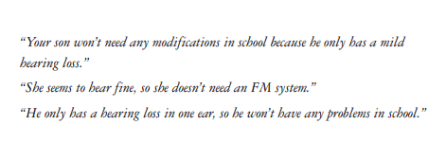
What people think:

Slide 67
Definitions
Permanent mild bilateral hearing loss: Calculated or predicted PTA is between 20-40 dB HL with at least thresholds greater than 25 dB HL at 2 or more frequencies above 2 kHz (3-8 kHz).
Permanent unilateral hearing loss- Calculated PTA of any level greater than 20 dB HL and pure tone thresholds grater than 25 dB HL at 2 or more frequencies above 2 kHz in the affected ear with an average PTA in the good ear at less than or equal to 15 dB HL.
(In both of these definitions when an air-bone gap of greater than 10 dB exists at any of the two of the same frequencies, medical intervention has been ruled out.)

Slide 68
Prevalence of hearing loss in newborns
Moderate loss (40 dB HL ) and greater: 1.13/ 10000
  Well baby: .49/1,000; NICU 4.8/ 1,000
Unilateral loss in the impaired ear .83/1000
  Well baby .41/1,000; NICU: 3.21/1,000

Slide 69
Prevalence of mild permanent bilateral and unilateral hearing loss at birth:
Different results from various authors: .55/1,000
Agreement:
  The numbers of children with mild hearing loss are under-identified and under-reported.
  Existing prevalence estimates of mild and unilateral permanent hearing loss in the newborn population is lower than prevalence rates of school age children.
  Current test protocols and pass-refer criteria will not identify the majority of infants with early -onset forms of permanent bilateral and unilateral mild hearing loss
  Challenges
    Calibration of OAE and ABR
    Insufficient manufacturer supporting evidence to validate specific pass-fail criteria and automated screening algorithms
    Potential variability in screening results as a function of earphone type (ABR technologies.
What is the sensitivity and specificity of existing protocols to identify mild loss? Establish efficient, effective and practical screening programs.

Slide 70
Management
A large number of children with this mild hearing loss are unidentified and are not receiving any kind of audiological management.
Late identification and lack of intervention impacts language development.
Do we have enough information from ABR and OAE test results to fit a child with amplification? Can we accurately determine the degree, type, and configuration of hearing gloss in infants? SMALL variation between normal and mild.
Waiting until a child is 6 months may allow more precise audiometric information via VRA and to treat middle ear pathology.

Slide 71
Remote Microphone for Minimal Hearing Loss
Previous studies show children with mild or UHL have decreased speech recognition in noise.
The use of an FM system with a remote environmental microphone and a receiver at the child’s ear will result in an improved S/N ratio and will therefore improve many children’s ability to understand speech in noise.
The signal from a remote microphone can be sent directly into the ear of a listener by using FM system technology and a variety of transmitters and receivers. This direct transmission from a remote microphone is commonly used in classrooms to reduce the interference between a child and the teacher.

Slide 72
Academic Performance for Unilateral or Mild Hearing loss
There is evidence to suggest that many children with minimal to mild hearing loss, including those with unilateral hearing loss, experience
  1) reduced speech recognition ability under adverse listening conditions;
  2) academic difficulties including poor performance on basic skills tests, low teacher ratings of communication and attention, grade failure, and need for resource assistance;
  3) social emotional dysfunction including low self-esteem, low energy, high stress, and need for social support;
  4) increased listening effort.

Slide 73
Right vs Left Ear
Anatomical and physiological asymmetry for speech perception in the brain provides a theoretical framework for risk of poorer outcomes in children with right ear hearing loss than in children with left ear hearing loss.
Only limited published data exist to support the theory that children with right ear hearing loss are at greater risk for negative outcomes than those with left ear loss.
Researchers with existing or prospective databases of unilateral loss outcomes should be encouraged to analyze their data to determine whether outcomes vary as a function of right vs. left ear hearing loss. Such data would help to determine whether children with right ear hearing loss should receive more aggressive intervention, such as more intensive early language therapy and/or amplification.

Slide 74
Clinical Implications of Children with Minimal Hearing Loss
Based on the literature, there is strong evidence that many school-age children with minimal hearing loss are at an elevated risk for developmental delays
A minimal hearing loss may have implications for a child’s ability to listen to and understand auditory information, a child’s speech and language development, and/or a child’s behavior.
While auditory information may be audible, even a minimal hearing loss can make sounds unintelligible
Distance hearing is also affected by a minimal hearing loss, and this loss of distance hearing can impact incidental learning. Issues related to the development of speech and language include the ability to hear word-sound distinctions that form important morphological markers and difficulty with word recognition and spelling.
Additionally, as a result of the amount of effort they expend in all listening situations, children with hearing loss may be more fatigued than their normal-hearing peers

Slide 75
Remote Mic/FM for Minimal Hearing Loss
Previous studies show children with mild or UHL have decreased speech recognition in noise.
The use of an FM system with a remote environmental microphone and a receiver at the child’s ear will result in an improved S/N ratio and will therefore improve many children’s ability to understand speech in noise.
The signal from a remote microphone can be sent directly into the ear of a listener by using FM system technology and a variety of transmitters and receivers. This direct transmission from a remote microphone is commonly used in classrooms to reduce the interference between a child and the teacher.

Slide 76
Unilateral Hearing Loss

Slide 77
1978 Northern & Downs
Hearing In Children
Audiologists and otolaryngologists are not usually concerned over such deafness [unilateral], other than to identify its etiology and assure parents that there will be no handicap.
What has changed?
  Earlier identification
  Aid? How to aid?

Slide 78
Unilateral Hearing Loss
Auditory Deprivation
What degree of unilateral hearing loss causes auditory deprivation?
  Early experience influences the way the brain processes sound.
  Congenital deaf individuals have reduced activation in the left temporal cortex compared to normal hearing controls.
  Animal models- changes in the CANS.
What is the critical time-period in which amplification should be provided to children with UHL?

Slide 79
Unilateral hearing loss
Should be referred to otolaryngologist w/ knowledge of pediatric hearing loss- imaging.
Masuda et al 2013 report internal auditory canal malformation in 66.7% of children/ increase to 85% in children under 12 mos.
EVA; enlarged vestibular aqueduct?
Other abnormalities; absent auditory nerve

Slide 80
Etiologic Factors Associated with UHL (Tharpe)
Cause | Frequency of Occurrence | Reference
Congenital Cytomegalovirus (CMV) | Leading Cause. Occurs in .-2-25% of all live births | Leung et al, 2003 Nance, 2007
Bacterial Meningitis | 30% cause UHL | Kutz et al, 2006
Viral/Bacterial Mumps | 80-90% of cases caused by viral or bacterial mumps are UHL. | Unal et al, 1998
Enlarged Vestibular Aqueduct Syndrome | Approximately 20% of cases of EVAS are UHL | Gvaerts, et al, 1999
Chiari Malformation | Majority are UHL (65%) | Podwall, et al, 2002
Sudden SNHL | 85% of cases in children are UHL | Roman et al, 2001
Atresia | Atresia or microtia occurs 1 in 10,000 births; 70% are UHL | Schuknecht, 1989
Gap Junction Beta | Over 80 mutations are responsible for HL. Some UHL. | Kenna et al, 2001 Wilcox, et al, 2000
 |  | Herrgard et al, 1995
Prematurity | 5% have minimal bilateral or UHL

Slide 81
Evidence-Based Practice
Evidence Based Practice is ever changing
  New research
    Overwhelming evidence of the detrimental effects
  New technology
    Cochlear Baha, Oticon Medical Ponto and ear-level FM
  More experience
    Patients who are successful or unsuccessful with each technology and families who say, “I wish we had done this sooner.”

Slide 82
JCIH 2019
Expansion of criteria for cochlear implantation including lowered age of candidacy, as well as other options (unilateral hearing loss, hybrid-devices for children with substantial residual hearing) to provide earlier auditory access to a larger population of children.

Slide 83
AAA 2013
Children with aidable unilateral hearing loss should be considered candidates for amplification in the impaired ear due to evidence for potential developmental and academic delays.
Children with unilateral hearing loss are at greater risk than children with normal hearing for speech and language delays and academic difficulties. For children with severe or profound unilateral hearing losses and normal hearing in the other ear, Contralateral Routing of Signal (CROS) or bone conduction devices may be considered depending on the child’s age and ability to control their environment.

Slide 84
Impact of UHL
Localization
  2 ears work together to find the source of sound
    The lost cell phone effect
Binaural Squelch
  The ability of 2 ears to “tune in” to a sound
    The cocktail party effect
Binaural summation
  Two ears hear sound at a quieter level than each ear individually.
    This is important for those of us with normal hearing to remember.
Head Shadow Effect
  Lateralized sound is received to one ear as a direct signal; the other ear is in the “head shadow”
    Low pitch sounds wrap around the head easier than highs

Slide 85
Real World Effects
Speech/Language Deficits
  Smaller vocabulary and less complex sentence structure (Shepard et al, 1981)
Cognitive Deficits
Social
Psychological Bess, 1998- stress, low self esteem, less energy, tired more frequently
Educational impact (Bess & Tharpe, 1986)
  More likely to repeat a grade
  Resource services
  Behavioral problem
Incidental Hearing (over-hearing)

Slide 86
What do the adults say? (Taylor, 2008)
Self-reported difficulties of adults with UHL
  Emphasis on post-surgical vestibular schwannoma
These adults reported significant difficulty
  Hearing in background noise
  Hearing when someone was on their “bad side”
  Localizing sound
    They also reported more difficulty even when sitting directly across the table from someone.

Slide 87
Single-Sided Deafness: Causes, and Solutions, Take Many Forms
The Hearing Journal. Weaver, Janelle Issue: Volume 68(3), March 2015, pp 20- 24
“Recent advances and successes in the management of single-sided deafness include improved wireless CROS systems, better options for bone-anchored devices, and the consideration of cochlear implants.”
“But we continue to forge ahead to dispel the old
belief that one ear is good enough.”
Role of Bone-Anchored Hearing Aids
Cochlear Implants

Slide 88
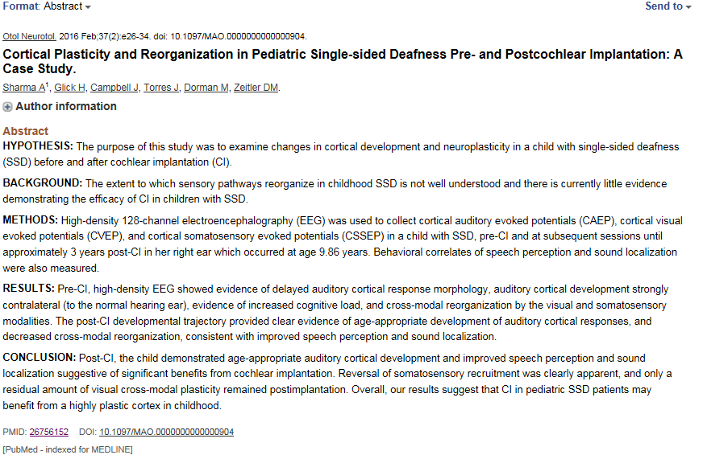

Slide 89
BREAK

Slide 91
Pediatric Hearing Loss Discussion Starters
• What challenges arise when coordinating care with teachers or parents?
• How do you differentiate listening fatigue from attention issues?
• How do you counsel families who say, “the hearing aids aren’t helping?”

Slide 92
Classroom Acoustics Prompts
• What’s the noisiest space in your school or clinic?
• How do you help teachers understand SNR?
• If you could improve one acoustic feature, what would it be?
Purpose:
Leads into FM/DM systems and acoustic treatment discussions.

Slide 93
Hearing Aids & Technology

Slide 94
Hearing Aid Selection: What the Audiologist Wants to Know
That the audiologist has achieved a good match between the amplification characteristics (gain, output, frequency response) of the hearing aids and the auditory characteristics of infants so that the use of residual auditory capacity can be maximized.

Slide 95
Hearing Aid Selection
Minimally, the fitting method employed to determine hearing aid characteristics should be audibility based
- with the goal to provide audibility of an appropriate amplified long-term average speech spectrum.
That is, the hearing aid should present all components of speech at a level that the infant can hear.

Slide 96
Technology
Hearing Aids
  Advanced Noise Reduction
    Improved intelligibility
  Microphones
Earmolds
Remote Microphone: When to begin use?
Bluetooth to Computers, CADs, etc
CI
BAHA

Slide 97
“Effective Amplification”
Amplification makes sounds louder so that a child is better able to hear
Verification
Hearing devices can be programmed to fit a child’s unique hearing loss
A child may need hearing devices when his or her hearing loss impacts the ability to learn language or communicate

Slide 98
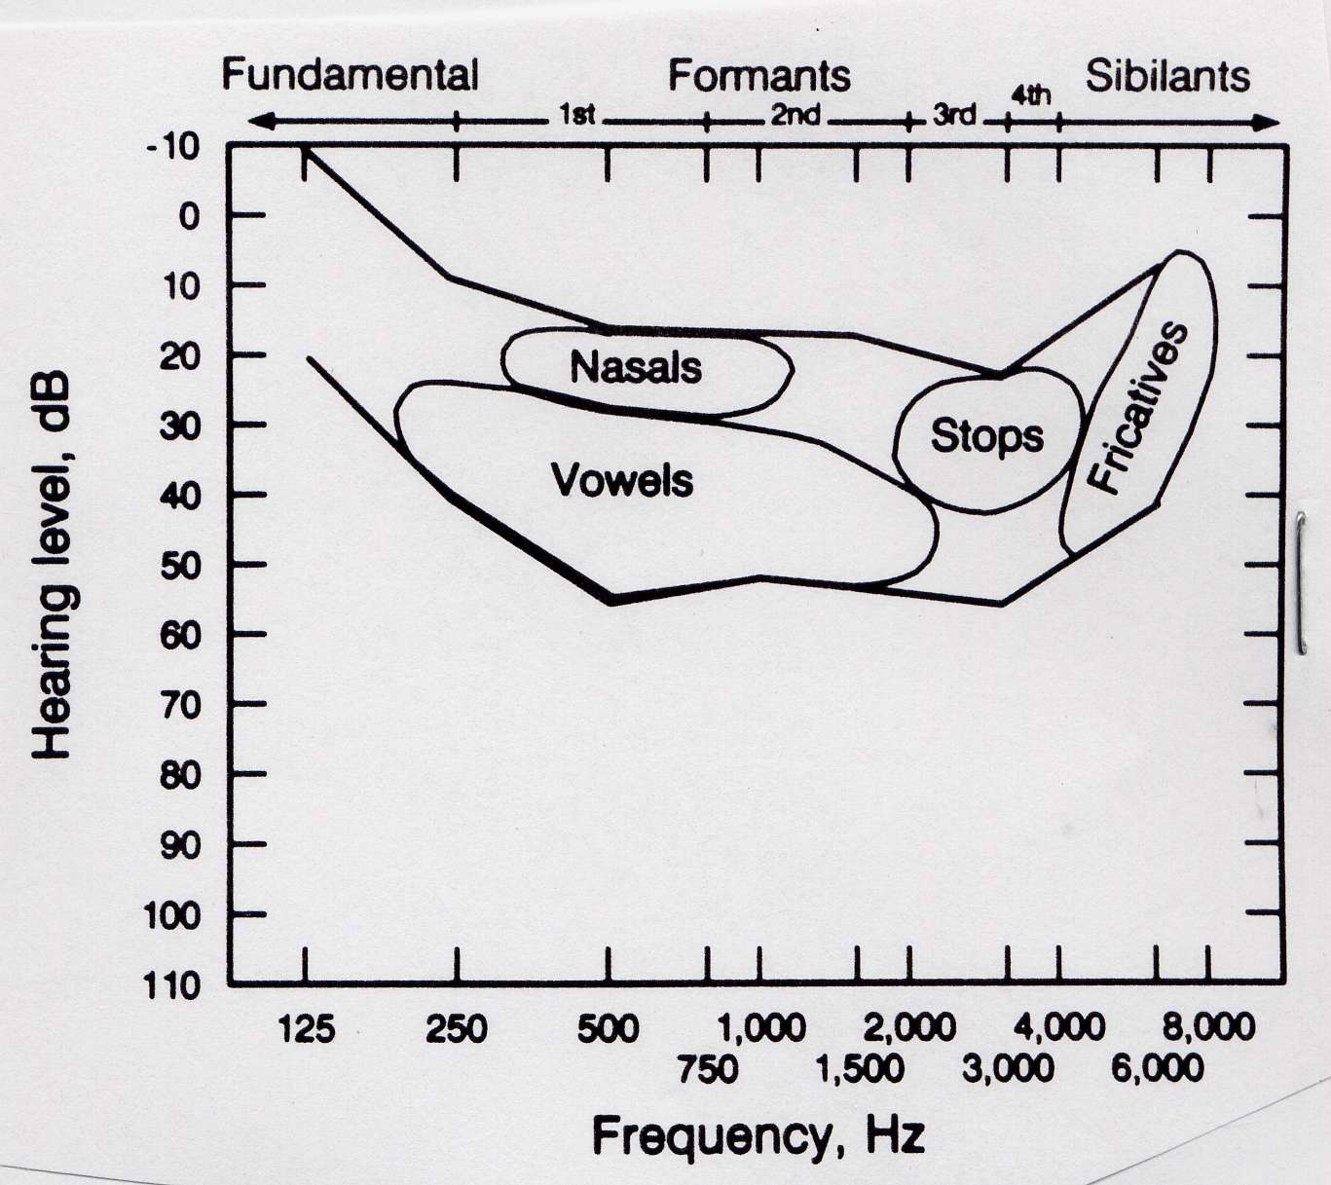
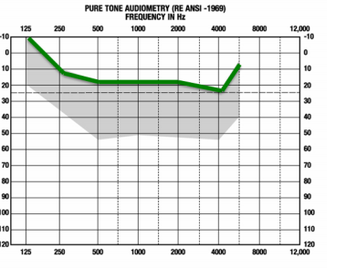
Phoneme Categories on Banana

Slide 99
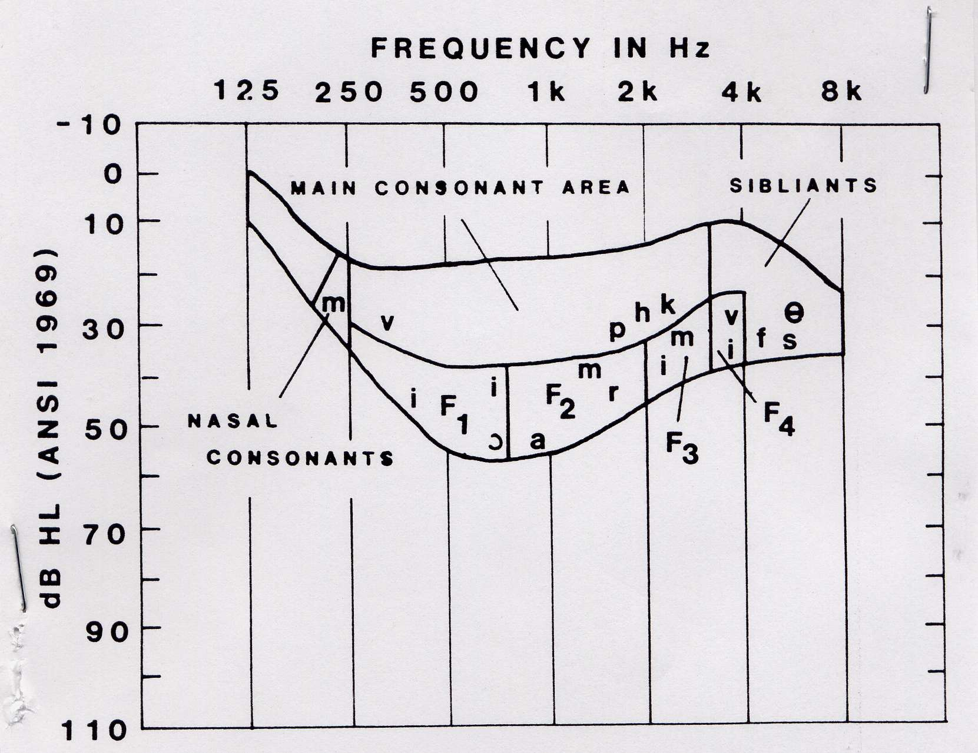
Phonemes on Banana
Need for the String Bean at the top

Slide 100
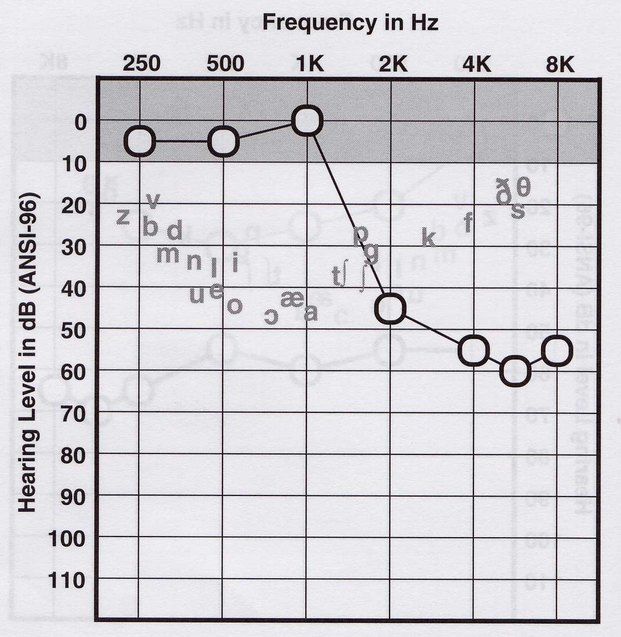
Traditional Strategy

Slide 101
Hearing loss, Listening Effort, and Fatigue

Slide 102
Complexities of Fatigue in Children w/ HL
F. Bess
Children with hearing loss are at increased risk for fatigue.
Fatigue- most common complaints in primary care settings; associated with chronic health conditions
Fatigue is related to energy level, listening effort and stress.
Physical fatigue & Mental fatigue
Cognitive fatigue- difficulties in concentration, increased distractibility, feelings of anxiety, reduced attentiveness or alertness and decrease in mental energy or efficiency. (Boksem & Tops, 2008)

Slide 103
How does fatigue effect children with hearing loss?
Not only are children with hearing loss listening to reduced auditory information , but there is also an increase in listening effort, stress, and fatigue could compromise the ability to learn in a noisy classroom environment thus increasing the risk for learning problems in school.
  Workloads: complete a written assignment, read a book or listen to the teacher and to other children in the classroom
Classroom acoustics: very poor

Slide 104
What happens when a child with hearing loss has fatigue?
Tired
Exhausted,
Naps
Do not participate in physical activities
Stress: Some clinics use questionnaires for mental health

Slide 105
Classroom strategies to help fatigue
Preferential seating to minimize environmental distractions
Slowing the pace of the lesson to allow for additional processing time
Limiting the duration of lessons when the content is auditory
Providing for small group instruction as often as possible
Separating time so that the child does not have to listen and work at the same time
Visual Aids
Note-taker
Provide more time to complete tasks
Pre-teach vocabulary
Advocacy skills
Education and in-service to teachers to talk about fatigue.

Slide 106
Stress and Cortisol
Cortisol: body’s stress hormone
Children with hearing loss show higher waking cortisol and blunted morning rise (Bess et al., 2015)
Indicates anticipatory stress and early-day energy depletion

Slide 107
Listening Effort with Devices
Hearing Aids: Amplify sound but don’t fully restore clarity (Hussein et al., 2022)
Cochlear Implants: Spectrally and temporally reduced signals (Saksida et al., 2022)
Objective measures like pupillometry and EEG show higher effort

Slide 108
Identifying Fatigue
Physical: tiredness, headaches, device removal
Cognitive: poor attention, disengagement
Social-Emotional: frustration, avoidance, mood changes
Tool: Pediatric Quality of Life Multidimensional Fatigue Scale (PedsQL-MFS)

Slide 109
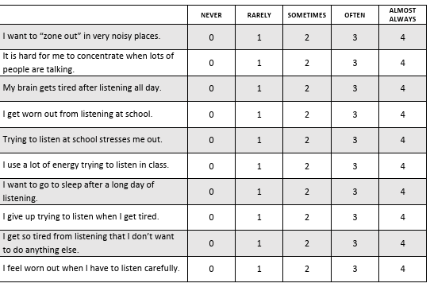
Vanderbilt Fatigue Scale

Slide 110
Classroom Acoustics
Background noise and reverberation degrade speech understanding
Optimal Signal-to-Noise Ratio (SNR): signal louder than noise
Ideal Reverberation Time (RT): 0.2–0.6 seconds (Nelson et al., 2002)
Poor SNR → academic & behavioral decline (Crandell & Smaldino, 2000)

Slide 111
Management & Accommodations
Reduce background noise and reverberation
Ensure consistent amplification use and listening checks
Provide flexible seating, listening breaks, and hearing assistive tech (FM, CAD systems)

Slide 112
Role of the Audiologist
Identify and monitor listening-related fatigue
Educate families and schools about acoustic optimization
Counsel on realistic expectations for devices and classroom support

Slide 113
Key Takeaways
Listening fatigue impacts learning and wellbeing
Stress and cognitive load measurable via cortisol and behavior
Audiologists play a vital role in prevention and management

Slide 114
Captioning

Slide 115
Definition
Captions are words displayed on a television, computer, mobile device, or movie screen, providing the speech or sound portion of a program or video via text.
Captions allow viewers to follow the dialogue and the action of a program simultaneously. For people with hearing loss who have residual hearing, captions can make the spoken words easier to understand—because hearing, like vision, is influenced by our expectations. (When you have an idea of what someone might be about to say, his or her speech may seem more clear).
Captions can also provide information about who is speaking or about sound effects that might be important to understanding a news story, political event, or the plot.
(Hearing Loss Association for America)

Slide 116
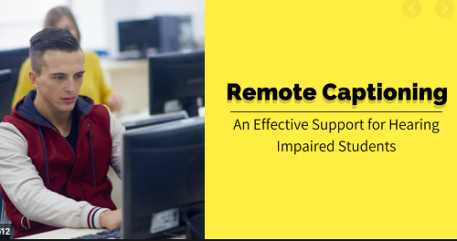
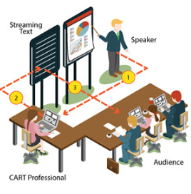
Communication Access Realtime Translation (CART)
Speech to text service
  In-person or may be through a remote service
Compliant with ADA

Slide 117
Remote Microphone Technology

Slide 118
Speech to text apps
Automatic Speech Recognition)
Dragon Family Products
Otter
Verbit
Speechmatics
Braina Pro
Amazon Transcribe
Microsoft Azure speech to Text
IBM Watson Speech to Text
Zoom captioning

Slide 119
Key Points/ Review
Teaching and learning is dependent, to a great degree, on talking and listening
1 in 6 words not understood by 1st graders in classrooms with poor acoustics
Canadian Language & Research Network Study (Bradley 2005)
Often unnoticed by administrators
Teachers see the effects but may not realize the cause
Poor classroom listening conditions = tangible lifelong impact on learning

Slide 120
Key Points
Children can’t learn if they can’t see
Children also can’t learn if they can’t hear and understand the spoken word
Students under age 13 are the most challenged
The auditory physiology is immature until secondary school.
  –As late as high school for some students
  Lack the vocabulary needed to fill in the blanks
Lack of understanding can affect speech perception, attention, behavior, and overall classroom performance

Slide 121
Problems with Speech to text software or apps
Complexity of the environment
Terminology in medical or legal professors

Slide 122
References
Patient Care and Management for Children Who Are Deaf or Hard of Hearing ASHA webinar #3950, 2014
Tharpe & Seewald (EDS) 2017. Comprehensive Handbook of Pediatric Audiology. Second Edition. Plural ISBN-10: 1597566152
Madell, J.R., Flexer, C., Wolf, J., Schafer ,E.C. (2019)Pediatric Audiology: Diagnosis, Technology, and Management, Third Edition Thieme
www.roberta-golinoff.com

Slide 123
What is the Family’s Desired Outcome?

Slide 124
Psychosocial Aspects of HL

Slide 125
Impacted Relationships
Lacking the ability to converse with a person with hearing loss will often unintentionally, create distance between themselves and the hard-of-hearing person because it is too difficult to understand.
  “Never mind.”
Misunderstandings
  Respond inappropriately
  Failure to respond

Slide 126
The psychological consequences may include:
Shame, guilt and anger
Embarrassment
Problems concentrating
Sadness or depression
Worry and frustration
Anxiety and suspiciousness
Insecurity
Self-criticism and low self-esteem/self-confidence

Slide 127
Hearing loss in the classroom
Pacing or turning while speaking
Talking with their back to the classroom
Writing on the whiteboard or blackboard
Bending down while speaking
Speaking while walking around the room or passing out assignments
Talking while creating other noises (rustling of papers, stacking of books)
Taking classes outside
DISRUPTIONS IN SIGNAL TRANSMISSION/LEARNING

Slide 128
Loss of Communication
Confusion
“Checking out”
Loss of self-reliance
Isolation
Loss of identity

Slide 129
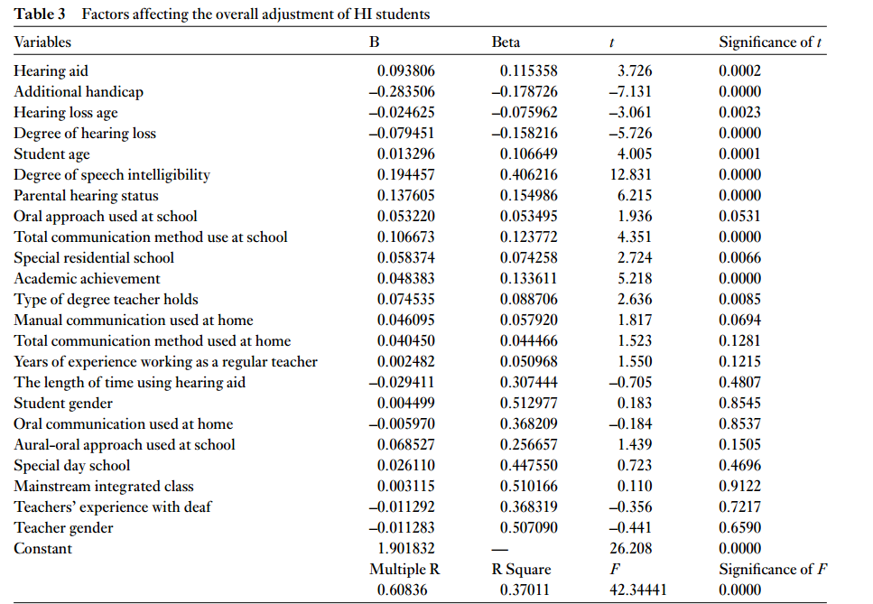
Polat, 2002, DOI: 10.1093/deafed/eng018

Slide 130
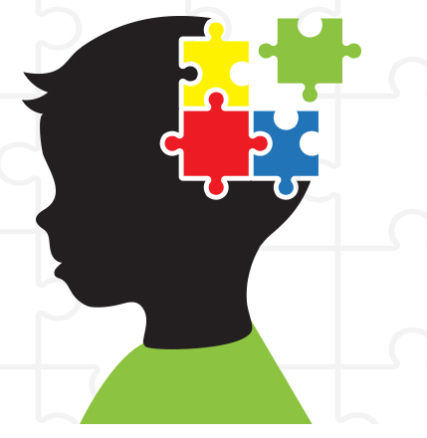
Theory of Mind (ToM)
is the ability to attribute mental states—beliefs, intents, desires,
pretending, knowledge, etc.—to oneself and others and
to understand that others have beliefs, desires, intentions, and
perspectives that are different from one's own.
Important in Reading Comprehension
Socialization
Even when they have good language skills, many children with hearing loss lag 3.5 years behind children with typical hearing in their ability to identify and describe the feelings of others, which is foundational to TOM development.
Research with 12-year-olds comparing children with typical hearing to those with hearing loss found that the TOM skills of a child with hearing loss were similar to those of a 6 year old with typical hearing.
There is a correlation between language level and understanding false beliefs that is due to diminished exposure to interactive conversations from a young age. Children who are ‘Deaf of Deaf’ do not appear to have TOM issues.

Slide 131
Mitigating the Psychological Effects of Teen Hearing Loss
Foster a Sense of Self
Build an Understanding Community
Learn to Communicate
Offer Space
Offer Help/Careers/Mentors/Coaches

Slide 132
Self Esteem in Children & Adolescents w/ HL
Warner-Czyn & Evans Trends in Hearing https://doi.org/10.1177/2331216515572615
Children with significant hearing loss are at risk for lower self-esteem, even after receiving HA or CI, due to differences from the mainstream relative to communication skills, physical appearance, and social maturity.
Self-esteem declines in late childhood and adolescence, possibly due to external feedback from teachers, parents, and peers based on academic, athletic, and social comparisons with other children
Boys and girls rate esteem identically until age 12.Maturational, emotional, and social changes during puberty mark a decline in self-esteem especially for girls, whose esteem decreases twice that of boys

Slide 133
From an AuD student with permission
At fifteen years old, I developed a progressive sensorineural loss while living in a rural part of XXX. My doctors referred me to the closest comprehensive healthcare facility over 2 hours away, however, my family could not accommodate this recommendation. A local audiologist fit me with hearing aids later that year.
Unfortunately, there were no counseling services, hearing aid verification measures or follow-ups. I felt lost, confused and isolated due to my hearing loss. A few years later when I was nineteen, a new audiologist provided appropriate and motivational aural rehabilitation counseling services to my family and myself. But it was not until I was twenty-four, that I had my hearing aids programmed and verified with real ear measurements.
The combination of appropriately fit hearing aids and aural rehabilitation has provided me with the opportunity for social and professional success as an adult with hearing loss. It is my belief that if a comprehensive office had been available closer to home when I was first diagnosed with hearing loss, neither my family nor I would have felt the distinctive psychosocial effects of hearing loss during my formative years. Due to my personal experience with hearing loss, I have a strong passion for comprehensive audiological services and treatment for patients of all ages. I have never let my hearing loss slow me down, and I strive to use my own experience this to empathize and connect with my patients.

Slide 134
Another student (with permission)
As a person with severe hearing loss, audiology has always been a beacon of hope for me. I lost most of my hearing at the age of two. Growing up, there were no other hard of hearing individuals at home or in school. Hardly anyone I encountered could appreciate what a hindrance hearing loss is to daily life. If a teacher was speaking and then turned to he board mid-sentence or the background noise increased, I would have no idea what was being said. The only person who understood these difficulties was my audiologist at the time, Dr. X. He had a great influence in my life and helped me in overcoming my obstacles. Dealing with my obstacles was not easy yet I know that these experiences have prepared me to help the deaf and hard of hearing community.

Slide 135
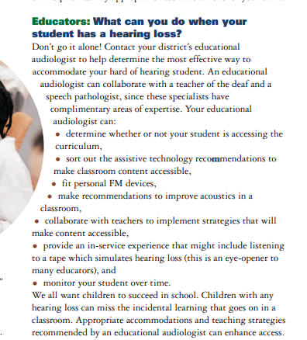

Slide 136
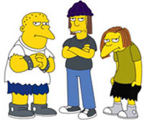
Bullies
Bullying includes hurtful acts, words, or other behavior. It is an oppressive or negative act carried out against you (or another) with intent to hurt or harm.
Studies have shown that the “words will never hurt you” adage is not true. Words can hurt just as much as physical violence. Make sure to take the right steps to prevent or end any bullying a teen has experienced.
Copyright © 2006, Alexander GrahamBell Association for the Deaf and Hard of Hearing

Slide 137
Encourage the HOH child
Learn self-advocacy skills.
Learn independent problem-solving methods.
Understand the disability in order to communicate this understanding to others. If the disability is not a “secret” it will be less powerful to bullies.
Maintain peer relationships. Once social skills are developed, the opportunity for isolation and vulnerability is reduced.
Find out if your school has an anti-bullying policy.

Slide 138
Unfortunately…
Student refuses to wear hearing aids so an ear-level personal FM cannot be used
History of “losing” or purposely damaging hearing devices
Lack of tolerance to wearing equipment (autism spectrum, cognitive delay, etc)
Student excels academically with hearing aids alone and refuses to use an FM system
Systems challenges for sound field FM or using a desktop system in secondary school

Slide 139
Questions/Discussions

Slide 140
References.
Anderson Gosselin, P., & Gagné, J. P. (2011). Use of a dual-task paradigm to measure listening effort. Ear and Hearing, 32(1), 116–121.
Bess, F. H., Dodd-Murphy, J., & Parker, R. A. (1998). Children with minimal sensorineural hearing loss: Prevalence, educational performance, and functional status. Ear and Hearing, 19(5), 339–354.
Bess, F. H., Gustafson, S. J., Corbett, B. A., Lambert, E. W., Camarata, S. M., & Hornsby, B. W. (2016). Salivary cortisol profiles of children with hearing loss. Ear and Hearing, 37(3), 334–344.
Boksem, M. A. S., & Tops, M. (2008). Mental fatigue: Costs and benefits. Brain Research Reviews, 59(1), 125–139.
Bradley, J. S., & Sato, H. (2008). The intelligibility of speech in elementary school classrooms. Canadian Language & Literacy Research Network.
Centers for Disease Control and Prevention. (2005). Final summary of 2005 national EHDI data (Version 6). www.cdc.gov/ncbddd/ehdi
Crandell, C. C., & Smaldino, J. J. (2000). Classroom acoustics for children with normal hearing and with hearing impairment. Language, Speech, and Hearing Services in Schools, 31(4), 362–370.
Flexer, C. (2018). Language learning through listening. www.roberta-golinoff.com
Gatehouse, S., & Noble, W. (2004). The Speech, Spatial and Qualities of Hearing Scale (SSQ). International Journal of Audiology, 43(2), 85–99.
Grimes, R. A. (2019). Update on newborn hearing screening.
Hicks, C. B., & Tharpe, A. M. (2002). Listening effort and fatigue in school-age children with and without hearing loss. Journal of Speech, Language, and Hearing Research, 45(3), 573–584.
Hussein, R., et al. (2022). Listening effort and fatigue in hearing aid users: A review. Trends in Hearing, 26, 1–17.

Slide 141
Jessica A. R. Logan, Laura M. Justice, Melike Yumuş, & Leydi Johana Chaparro-Moreno. (2019). When children are not read to at home. *Journal of Developmental & Behavioral Pediatrics, 40*(1), 1–9. https://doi.org/10.1097/DBP.0000000000000657
Kahneman, D., & Beatty, J. (1966). Pupil diameter and load on memory. *Science, 154*(3756), 1583–1585.
Madell, J. R., Flexer, C., Wolf, J., & Schafer, E. C. (2019). *Pediatric audiology: Diagnosis, technology, and management* (3rd ed.). Thieme.
Masuda, S., et al. (2013). Inner ear malformations in children with unilateral hearing loss. *International Journal of Pediatric Otorhinolaryngology, 77*(5), 703–708.
Mirman, D. (2014). *Growth curve analysis and visualization using R.* CRC Press.
Nelson, P. B., Soli, S. D., & Seltz, A. (2002). Acoustical barriers to learning: Children at risk in every classroom. *Language, Speech, and Hearing Services in Schools, 33*(3), 356–361.
Peele, J. E. (2018). Listening effort: How the cognitive consequences of acoustic challenge are reflected in brain and behavior. *Ear and Hearing, 39*(2), 204–214.
Pichora-Fuller, M. K., et al. (2016). Hearing impairment and cognitive energy: The Framework for Understanding Effortful Listening (FUEL). *Ear and Hearing, 37*(S1), 5S–27S.
Polat, F. (2003). Factors affecting psychosocial adjustment of deaf students. *Journal of Deaf Studies and Deaf Education, 8*(3), 325–339. https://doi.org/10.1093/deafed/eng018
Shepard, N. T., et al. (1981). Unilateral hearing loss in children. *Pediatrics, 67*(1), 123–126.
Tharpe, A. M., & Seewald, R. (Eds.). (2017). *Comprehensive handbook of pediatric audiology* (2nd ed.). Plural Publishing.
Warner-Czyz, A. D., & Evans, C. (2015). Self-esteem in children and adolescents with hearing loss. *Trends in Hearing, 19*, 1–10. https://doi.org/10.1177/2331216515572615
Weaver, J. (2015). Single-sided deafness: Causes, and solutions take many forms. *The Hearing Journal, 68*(3), 20–24.

