Slide 1

Educational Audiology in Schools: Foundations, Complex Cases, and Practical Strategies
Annette Hurley, Ph.D., CCC-A
Louisiana State University Health Sciences Center

Slide 2
Overview
This morning’s session explored the foundations of educational audiology—highlighting the importance of hearing and listening in learning and communication. Even mild or unilateral hearing loss can affect speech, language, academic performance, and social-emotional well-being.

Slide 3
Hearing vs. Listening
Hearing is passive; listening is active.
Listening requires attention, interpretation, and memory.
Noise and degraded signals increase listening effort.

Slide 4
Listening Effort and Fatigue
• Children with hearing loss expend more cognitive energy to understand speech.
• Leads to fatigue, stress, and reduced engagement.
• Physiologic (pupil dilation, cortisol) and behavioral evidence confirm this.
• Audiologists should recognize fatigue and recommend strategies to reduce load.

Slide 5
Early Detection and Prevalence
• Hearing loss is the most common birth condition.
• 1-3-6 goals: Screen by 1 month, diagnose by 3 months, intervene by 6 months.
• Loss to follow-up and access barriers to intervention remain challenges.

Slide 6
Educational and Psychosocial Impact
• Even mild or unilateral hearing loss is educationally significant.
• Challenges: speech recognition in noise, fatigue, lower self-esteem.
• Collaboration among audiologists, educators, and families is essential.

Slide 7
Technology and Classroom Support
• Remote microphone and FM systems improve SNR.
• Captioning and speech-to-text enhance access.
• Consistent amplification use and good acoustics support learning.
• Audiologists guide technology fitting and training.

Slide 8
Looking Ahead to the Afternoon
We’ll build on these foundations with case-based learning, focusing on:
• Classroom strategies and environmental modifications
• Supporting students with hearing loss, ASD, and CVI
• Interprofessional collaboration and advocacy

Slide 9

Autism Spectrum Disorder

Slide 10
Incidence and Prevalence
Epidemic
  1 in 54 (CDC, 2020)
  1 in 59 in children with hearing loss (Szymanski et al, 2012)
That means approximately 1.5 million Americans have some degree of ASD, according to the 2018Autism Prevalence Report from the Autism and Developmental Disabilities Monitoring Network at the Centers for Disease Control and Prevention.

Slide 11
Structural Brain Differences
Several structural and functional neurobiological abnormalities may contribute to the sensory processing impairments exhibited by children with ASD.
Several regions of the autistic brain show abnormalities including differences in head circumference, frontal lobe hyperplasia (an excess of cells or tissue), abnormal cortical organization, abnormal minicolumn structure in frontal and temporal areas, and variations in white and gray matter and sensory deficits

Slide 12
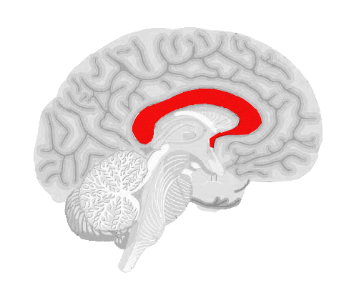
Corpus Callosum and Auditory Function
CC is a body of neural fibers connecting the right and left hemispheres
CC is anatomically divided into several regions: genu, anterior body, posterior body, isthmus, and splenium
Optimal and efficient processing occurs when the two hemispheres interact

Slide 13
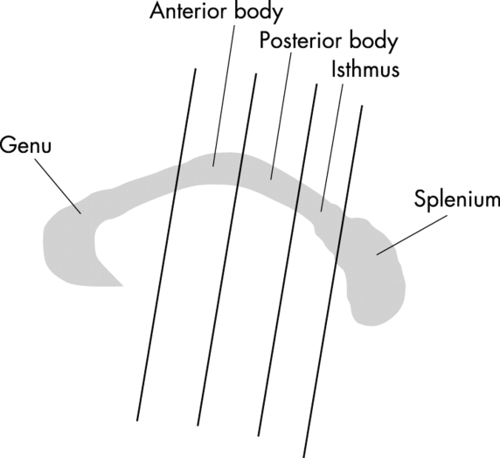
ASD and Differences in Corpus Callosum
  Children with ASD have reductions in size of the body and posterior sub regions, anterior regions, splenium, isthmus, genu, rostrum ( Harden et al, 2009)
Decreased connectivity in inter and intra-hemispheric communication
Abnormality of cortical connectivity leads to a disruption of integrative and interhemispheric processing
Altered development of the CC may play in the social, emotional and communiction deficits in autism.

Slide 14

Corpus Callosum and Auditory Function
Different regions of the CC have specialized sensory functions
Posterior portion, isthmus or sulcus is specialized for auditory information
Splenium is sensitive to auditory function
Optimal and efficient processing
occurs when the two
hemispheres interact

Slide 15
Electrophysiological Responses
The function and organization of sensory pathways can be assessed by evoked potentials.
Differences in transmission of the brainstem ( Rosenhall et al 2003) review of 10 previous studies
  Auditory Brainstem Response (ABR)
    A test of neural synchrony from the peripheral VIII CN to the upper brainstem.
    Previous research show increased transmission time.
    I-III, IIII-V, I-V, interaural differences
“..Brainstem abnormalities suggest that the brainstem may be partly responsible for deviant language, cognitive and social development in children with ASD.”
Notes:
Electro. Measures offer an objective temporal window to measure auditory processing in a non-invasive and passive manner
Brainstem abnormalities may be due to genetic defect affecting the HOXA1 gene on chromosone 7
Maturational defect in myelination

Slide 16
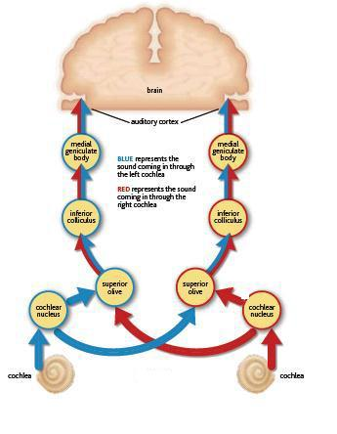
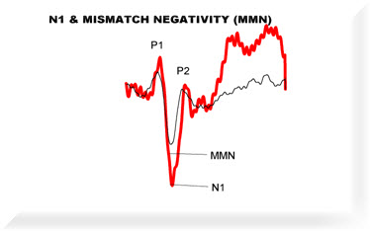
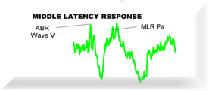
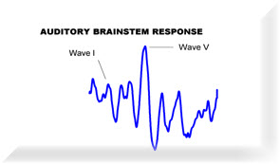

Slide 17
Brain Differences (Cont.)
Russo et al (2008) reported differences in subgroup of children with ASD, although the population did not differ in behavioral tests of receptive or expressive language but did differ in cABR.
  Difficulty with deficient pitch tracking
  Reduced phase-locking ability (inability of the neurons to fire synchronously
    May benefit from auditory training.
Russo et al (2009) report children with ASD hear as if they are hearing in background noise
Notes:
Associated with encoding the fundamental frequency of sounds
Difficulty understanding of prosody.
Information used in language comprehension comes from the ability to attach meaning to the supra-segmental aspects of speech such as rise and fall of pitch across time and the use of pause within phrases.
Distinguishing between male and female speakers
Intention and emotion
Children with ASD who have a disordered representation of speech may incorrectly perceive the intention of what is said.

Slide 18
Auditory Cortical Response
P300- oddball paradigm
Smaller amplitude in patients with ASD in comparison to control group (Bomba et al, 2004; Novic et al, 1979, 1980; Courchesne et al, 1984, 1985)
May be related to failure to attach appropriate significance to novel stimuli or integrating past experiences to current stimuli.
Mismatch negativity
Shorter latency and larger amplitude (Ferri et al, 2003; Gomot et al, 2002)
Higher cerebral reactivity to the deviance which may reflect hypersensitivity to acoustic change
MMN absent in speech syllables (Kuhl et al, 2005)

Slide 19
Otoacoustic Emissions
Otoacoustic emissions are responses generated by the outer hair cells of the cochlea.
Khalfa et al. (2001) reported a decrease in TEOAE amplitudes for children with ASD but not for typically developing peers, possibly suggesting a premature deterioration of outer hair cell function.

Slide 20
Efferent Auditory System
Abnormalities have also been reported the efferent auditory system in individuals with ASD.
In humans, the medial olivochohlear (MOC) reflex has been investigated using recordings of OAEs during the simultaneous presentation of contralateral broadband noise TEOAE recordings (Berlin, Hood, Hurley, & Wen, 1994).
Several investigations have reported redueced suppression in individuals with ASD (Bennetto, Keith, Allen, & Luebka, 2018; Khalfa et al, 2001;).
These differences may contribute to some of the auditory processing complaints in individuals with ASD such as hearing in background noise.

Slide 21
Barriers in Testing ‘Difficult’ Children
Repeat Visits to obtain meaningful data
  Degree/Configuration
Challenging
Time-intensive
May need ‘extra’ set of hands

Slide 22
What makes a child with ASD difficult to test?
Increased/ decreased sensitivity
Cognitive dysfunction
Language Comprehension
Difficulty in Adapting to new situations
Does not want their ears touched
Does not want earphones/inserts etc.
Increased anxiety
Habituates
Increase in false positives
Increase in false negatives
New environment
(from Rosenhall et al 1999

Slide 23
Important to rule out hearing loss
Similar behavioral responses
Similar communication difficulties
Parents may report reduced language comprehension, limited use of gestures, delayed speech with no babbling, unusual verbalizations. These behaviors make differentially diagnosing hearing loss from ASD challenging.
Poor eye contact- social cognitive deficits; but children with hearing loss may have poor eye contact resulting from comprehension struggles.

Slide 24
 | ASD | Hearing Loss
Social Communication | Atypical eye contact Limited social interaction | Appropriate Social Smile Appropriate Eye Contact Appropriate Reciprocal Behavioral Engages in their environment
Interactive Communication | Abnormalities in body language Limited facial expressions and gestures Difficulties in non-verbal language | Appropriate eye contact Wide range of gestures Language learning will follow sequence as typical peers May have some difficulty with vocabulary, grammar, or other idiomatic expressions
Repetitive Speech | Repetitive speech (i.e., Echolalia or idiosyncratic language) | Typically follows normal language development Echolalia occurs only as a developmental stage, does not continue.

Slide 25
ASD and (C)APD
ASHA Definition of (C)APD
  “Deficit in the perceptual processing of acoustic stimuli and the neurobiologic activity that underlies those processes and gives rise to the auditory evoked potentials”
Auditory Complaints in children with ASD may be regarded as part of the higher order cognitive disorder
Label of CAPD is not appropriate
Notes:
Cut thus out, combine with next slide

Slide 26
ASD and Auditory Processing Difficulties
Auditory Difficulties may be due in part to organic brain differences
Frazier & Harden (2009) report strong evidence the Corpus callosum is involved in the pathophysiology of autism.
Therefore, targeting interventions which specifically seek to improve the efficiency of information transfer across the corpus callosum may be useful.
Diagnosis of Autism may prevent referrals to qualified specialists who may be able to offer auditory training or remediation programs

Slide 27
Who can address these problems?
Audiology Must Take its Rightful Place on the Autism Team (2012) Hearing Journal 65: 18-20 by Carol Lau
“In my clinical practice, we have assessed approximately 600 adults and children for APD since 2004. Approximately 75 percent of patients diagnosed with APD in our clinic also have a diagnosis of Sensory Processing Disorder. About 40 percent of patients diagnosed with APD also had a diagnosis of ASD including high-functioning autism, Asperger’s syndrome, and pervasive developmental disorder- non-specific (PDD-NOS). Most of the children assessed were referred to us by occupational therapists specializing in SPD and developmental optometrists who specialize in visual processing.”

Slide 28
From C.A. Lau….
“ASD children benefit significantly from intense, appropriate auditory training, but may require longer intervention than children with only APD. I have treated approximately 80 children with ASD in our clinic, and have noted the profound effects of appropriate auditory training on those ASD children. We consistently see improvements such as increased verbal output, improved “presence” and engagement in conversations, and improved language pragmatics, attention, and ability to follow instructions.”

Slide 29
Dichotic Listening
Previous studies have shown left ear deficits in dichotic listening tests in individuals with ASD.
  (Arnold & Schwartz, 1983; Hayashi et al, 1989;Student & Sohmer, 1978; Wetherby et al, 1981)
Anecdotal reports from this author

Slide 30
Cortical Visual Impairment

Slide 31
Cortical Visual Impairment (CVI): What Audiologists Need to Know
Summary prepared for audiologists by Annette Hurley, Ph.D., CCC-A

Slide 32
Overview: What is CVI?
CVI is a brain-based visual disorder caused by injury or abnormal development of the brain’s visual processing areas.
The eyes may appear normal, but the brain struggles to interpret visual input.
CVI is now one of the leading causes of visual impairment in children, especially those with neurological conditions.

Slide 33
Why Audiologists Should Care
Many children referred for Auditory Processing Disorder (APD) may actually have CVI or coexisting visual processing deficits.
CVI can cause inconsistent attention, poor listening-in-noise, and behaviors that mimic auditory or language disorders.
Awareness helps audiologists avoid misdiagnosis and make accurate referrals.

Slide 34
Common Characteristics of CVI
- Variability in visual performance
- Difficulty locating or recognizing objects
- Preference for simple, high-contrast visuals
- Problems with scanning or shifting gaze
- Light sensitivity or fascination with light
- Visual fatigue and reduced attention span

Slide 35
CVI Red Flags in Audiology Evaluations
• Inconsistent responses to visually supported tasks
• Difficulty maintaining visual attention
• Excessive light gazing or light sensitivity
• Delayed visual-motor coordination
• Better performance in simplified environments

Slide 36
Differential Diagnosis: CVI vs APD
CVI: Visual processing disorder (brain-based)
Light-gazing, poor visual attention, difficulty with complex visuals
APD: Auditory processing disorder
• Difficulty following directions, poor speech-in-noise understanding

Slide 37
Overlap:
Both can lead to inattentive or inconsistent responses
Multisensory testing and observation are key

Slide 38
Case Studies
Case 1 – Misdiagnosed APD:
• 7-year-old with normal APD results but poor classroom listening.
Light-gazing and perinatal hypoxia → diagnosed with CVI.
Visual accommodations improved performance.
Case 2 – Collaborative Success:
• 5-year-old with mild hearing loss and cerebral palsy.
CVI identified collaboratively → high-contrast visuals, multimodal supports.

Slide 39
Audiologist’s Role in Multidisciplinary Care
Recognize visual indicators during auditory testing.
Refer for vision or neurological assessment when appropriate.
Collaborate with OTs, teachers, and vision specialists.
Suggest environmental adaptations (e.g., high-contrast visuals, reduced clutter).
Support families with education and advocacy.

Slide 40
Key Takeaways
CVI can mimic or compound auditory/language disorders.
Audiologists should look for visual red flags and refer early.
Interdisciplinary care leads to better outcomes.
Understanding CVI enhances diagnostic accuracy and family counseling.

Slide 41
Updated Clinical Guidance for Audiologists
Include a brief vision/CVI screen before interpreting APD test performance.
Rule out visual confounds to ensure accurate APD results.
Document visual history and observed attention/behavior during testing.
Use multisensory observation and note inconsistency patterns.

Slide 42
Audiology Booth and Test Environment Setup
Lighting: Avoid glare; use side or indirect lighting.
Visual Clutter: Remove posters or busy backgrounds.
Seating: Position child with light source behind them.
Present visuals in preferred visual field at near distance.
Allow posture adjustments and slower pacing.

Slide 43
Audiovisual (A/V) and Communication Considerations
Children with CVI may not benefit from lipreading or rapid visual cues.
Prioritize clear auditory input (e.g., remote microphone systems).
Simplify visuals—'less is more' for processing efficiency.
Encourage tactile or auditory cues rather than visual overload.

Slide 44
AAC and Educational Implications
AAC displays for CVI should use high contrast, fewer icons per page, and consistent layouts.
Visual fatigue and complexity can cause device rejection or frustration.
Classroom accommodations: reduce visual clutter, manage glare, and use real-object/tactile supports.
Embed CVI-informed strategies into IEP/IFSP recommendations.

Slide 45
CVI Risk Factors and Audiology Intake Checklist
Add risk-factor screening: hypoxia, prematurity, cerebral palsy, CMV/meningitis, hydrocephalus, TBI.
Document developmental and neurological history.
Consider CVI when auditory test results are normal but functional listening is poor.
Adjust test pace, lighting, and visual supports accordingly.

Slide 46
Mobility and Visual-Motor Considerations
Children with CVI may have difficulty with depth, steps, and spatial navigation.
Create clear, high-contrast paths to and from the booth.
Allow extra time between tasks to reduce fatigue.
Consider these when evaluating performance or scheduling longer sessions.

Slide 47
Interdisciplinary and IEP/IFSP Collaboration
Recommend accommodations using CVI-informed language (e.g., high-contrast, predictable visual fields).
Collaborate with Teachers of the Visually Impaired (TVI), O&M specialists, and therapists.
Include CVI phase–aligned supports in reports and team meetings.
Emphasize family-centered, interdisciplinary approaches for optimal outcomes.

Slide 48
Signs Of Possible Functional Vision Problems
If your child's eyes are not working well together, these are a few of the signs that you may see in your child during schoolwork:
  tilts or moves head while reading or writing
  covers one eye when reading or writing
  loses place or leaves out words when reading or writing
  reads very slowly, with a great deal of effort
  reading or writing deteriorates as the lesson goes on
  complains of tired eyes / rubs eyes / eyes watering during reading and writing work
  easily distracted and shows poor concentration

Slide 49
Visual Defensiveness
(Visually Over-Responsive)
he/she dislikes and avoids bright lights and being outdoors on a sunny day
dislike watching moving objects such as merry-go-rounds, or may feel stressed by the unpredictable movements of kids in the park
may easily become dizzy or nauseous being in an environment which is visually busy (eg the bustle of a fairground)

Slide 50
Visually Under-Responsive
A child may walk in the path of a moving swing or may not duck out of the way of a falling object, because the brain is under-responsive to the visual information coming from the eyes.

Slide 51
Poor Visual Discrimination
Among other things, a child with this difficulty may find it hard to differentiate similar looking letters and words (such as b, d, p, or 2, 5, S).
He or she may struggle with depth perception, spatial relationships and with reading other people’s non-verbal body language (eg facial expressions).

Slide 52
Poor Visual-Motor Skills
Difficulty with hand-eye coordination
Difficulty with fine motor activities
  Threading beads
  handwriting

Slide 53
Cortical Visual Impairment
Visual Processing
Often present in children with CP, developmental disabilities and other sensory processing deficits (Kran 2019).
Lag in maturation
Problems
  Not recognizing differences in shapes, letters, or numbers
  Difficulty writing letters, shapes, copying
  Reading difficulties
  Difficulty staying in lines/mazes
  Identification of objects
  Locating a specific image
  Bumping into things

Slide 54
Audio-Visual Integration
Sensory bombardment
  Visual orientation to sound
  Auditory stimuli can influence visual information
  Incongruent (vision does not match auditory)
‘trying to understand in a noisy room- rely on visual information (Ma et al, 2009)

Slide 55

Auditory/Visual
Multi-disciplinary team
OT
Modifying the environment
Reduce distractions

Slide 56
Auditory Neuropathy Spectrum Disorder (ANSD)

Slide 57
Implications for Education
- Students may appear inattentive or unmotivated
- Visual access to curriculum may be inconsistent
- Misinterpretation of behaviors is common
- Fluctuating performance can lead to frustration
- Educators must recognize and adapt classroom environments

Slide 58
Auditory Neuropathy Spectrum Disorder
Definition: A form of hearing impairment in which the outer hair cell function works properly, but neural transmission in the auditory pathway is disordered.
  Approximately 7% of permanent severe to profound childhood hearing loss.
Characterized by neural dys-synchrony (poor timing of neural firing).
• 'Spectrum' reflects variable sites of dysfunction and a range of impacts.

Slide 59
HEARING LOSS | AN/AD | (C)APD
Family History | Family History | Family History
Infections: [Toxoplasmosis, Rubella, Cytomegalovirus (CMV), Herpes Virus, Syphilis] | Infections: [Toxoplasmosis, Rubella, Cytomegalovirus (CMV), Herpes Virus, Syphilis] | Infections: [Toxoplasmosis, Rubella, Cytomegalovirus (CMV), Herpes Virus, Syphilis]
Hyperbilirubinemia | Hyperbilirubinemia | Hyperbilirubinemia
Craniofacial Anomalies | Immune Disorders (Type 1 Diabetes) | RH Incompatibility
Low Birth Weight | Uremia | Difficulty During Birth
Other Syndromes | Genetic/Syndrome | Toxic Exposures
Ototoxic Medications |  | Ototoxic Medications
Prematurity |  | Prematurity
Anoxia |  | Anoxia
Infections after Birth |  | Infections after Birth
Mechanical Ventilation |  | Head Trauma
Bacterial Meningitis |  | Cerebrovascular Disorders
 |  | Metabolic Disorders Epilepsy Recurrent Otitis Media Meningitis/Encephalitis Developmental Disorders (e.g. Dyslexia, Learning Disability, Language Impairment, Attention Deficit Hyperactivity Disorder)

Slide 60
Pathophysiology
Possible sites of dysfunction:
• Inner hair cells (neurotransmitter release)
• Synaptic junction (e.g., OTOF mutation)
• Auditory nerve fibers (demyelination)
Common causes:
• Genetic mutations
• Hyperbilirubinemia
• Hypoxia
• Prematurity
• CMV infection

Slide 61
ANSD & CAPD
Have never had a patient referral for CAPD and learn that it is ANSD
Patients with ANSD will have CAPD

Slide 62
Audiometric Test/Procedure | Auditory Neuropathy | (C)APD
Pure Tone Thresholds | Various degrees of hearing loss and configurations | Usually within normal limits
Tympanometry
Acoustic Reflexes Speech Recognition in Quiet Speech Recognition in Noise | Elevated or Absent Poor | Usually within normal limits depending upon site(s) of central auditory nervous system (CANS) dysfunction Variable, depending upon site(s) of CANS dysfunction
Otoacoustic Emissions | Present | Present
Gap Detection | Abnormal | Often abnormal, depending upon site(s) of central auditory nervous system (CANS) dysfunction
ABR MLR ALLR/P300 | Absent Questionable Questionable | Usually normal Depending upon site(s) of central auditory nervous system (CANS) dysfunction Variable, depending upon site(s) of CANS dysfunction

Slide 63
Educational and Functional Impact
• Listening fatigue
• Poor speech perception
• Language and literacy delays
• Inconsistent auditory responses

Slide 64
Management Strategies
Medical / Audiologic:
• Cochlear implants may restore neural synchrony.
• Hearing aids provide limited benefit.
• FM/DM systems improve SNR.
Therapeutic / Educational:
• Speech-language therapy with auditory training.
• Visual supports and quiet learning environments.

Slide 65
Key Takeaways
• ANSD = disorder of neural timing, not sound detection.
• OAE present + ABR absent = diagnostic hallmark.
• Mimics auditory processing deficits.
• Requires multidisciplinary management.

Slide 66
CASES

Slide 67
Abe is a seventeen-year-old male who was identified with auditory neuropathy spectrum disorder (ANSD) shortly after birth. Abe was bilaterally fitted with hearing aids at two months of age, but currently wears only one hearing aid in the right ear, and only while attending school. He reports that he stopped wearing his hearing aid in his left ear during upper elementary school as he did not receive any benefit from the device and because the hearing aid “sounded like loud noise.” He reports experiencing difficulty in background noise and in situations with multiple talkers. Although he reported improvement with his FM system, he does not use this device. His resistance to using the device is self-reported as “peer- related.” Abe attends a private school with small classes. He reported that his teachers know about his hearing difficulty and are very helpful when he needs clarifications. He will graduate from high school with honors in just a few weeks.
The purpose of this assessment is to provide documentation for disability services.

Slide 68
Table 21-5. Audiometric Thresholds in dB HL for Case Study 4 (Abe).
Frequency (Hz) | 250 | 500 | 1000 | 2000 | 4000 | 8000
Right air conduction | 30 | 40 | 40 | 60 | 65 | 50
Left air conduction | 30 | 40 | 45 | 60 | 70 | 55
Unmasked bone | 20 | 35 | 40 | 55 | 65

Slide 69
Table 21-6. Behavioral CAPD Test Results for Case 5 (Abe).
Gaps-in-Noise Threshold |  | Dichotic Digits |  | Frequency Patterns |  |  | Masking Level Difference
Left | Right | Left | Right | Left | Right |  | 6 dB HL
20 ms | 6 ms | 90% | 98% | 100% |  | 100%
Abnormal | Normal | Normal |  | Normal |  |  | Abnormal

Slide 70
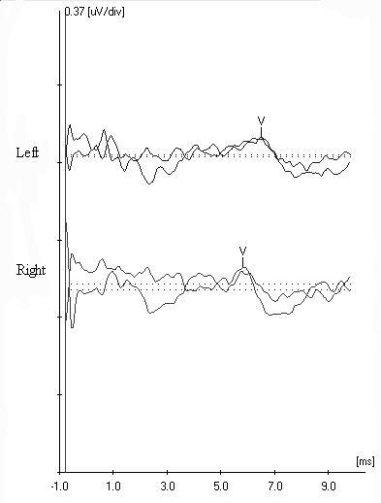
Abe’s ABR

Slide 71
ANSD patient Office of Disability Services
Dear Director,
I have been asked to help in completing Documentation Guidelines for Physical Disabilities for Xxxx Xxxx. Enclosed you will find his latest audiogram and test results from our clinic.
Specific Diagnosis
Auditory Neuropathy/Auditory Spectrum Disorder (AN/AD)
ICD-9-CM: 389.12 (neural hearing loss, bilateral)
Relevant history and date of the last visit with this person:
Xxxx was last seen at this clinic on 6/15XX in order to obtain additional information regarding his difficulty understanding speech. Xxxx has a (central) auditory processing disorder as a result from his Auditory Neuropathy/Auditory D-synchrony (AN/AD) and has been managed by the audiologists in the Dept. of Otolaryngology, LSUHSC . Xxxx presents with a moderate-to severe neural hearing loss. Audiometric thresholds have remained stable and are essentially symmetrical between ears. However, Xxxx prefers to wear only one hearing aid, the one for his right ear and does not feel that a hearing aid in the left ear is helpful.

Slide 72
RECOMMENDATIONS:
Hearing aid amplification with directional microphones. Binaural amplification should be tried. We must rely on Xxxx to give feedback of the benefits of the left hearing aid. Because of the AN/AD, it is possible that benefit will be limited.
Continue to receive audiological monitoring every 12 months. Xxxx’s hearing has remained stable, but we should continue monitoring.
A possible neurological consultation should be considered. A majority of patients with AN/AD have other peripheral neuropathies, although hearing loss may be their only complaint. A consult to a neurologist may rule out other unknown etiologies may be useful.
Given Xxxx’s vulnerability to missing instructions and directions- or information out of context- visual feedback of instructions, assignments, and directions are strongly recommended.
Xxxx will need extended time for in-class and national examinations that require extensive amounts of reading and/or writing.
Testing in a distraction free area will also be best for Xxxx.

Slide 73
7.Xxxx should receive 504 accommodations in school because of his peripheral and central hearing loss. We spoke to Xxxx about his hearing. He is working much harder than his peers to discern the auditory signal not only at a decreased sensation level, but he must ‘process’ this ‘distorted signal’ into something that is meaningful to him (language). Even though we can increase the volume to make things more audible for him, the AN/AD makes speech distorted and unclear. This is important to remember! Classroom accommodations that might be useful are:
  Remote Microphone system. With new hearing aids, it is possible for a wireless connection so that he is receiving an increased signal-to-noise ratio, with his hearing aids, without wearing additional hardware.
  Strategic Seating. Xxxx has great difficulty understanding speech- especially in degraded acoustic environments. He should be sitting close to the speaker, away from distractions. This may require Xxxx investigating several positions, so that he can pick the one that is best for him. It should be important for his right ear to be closer to the speaker.
  Note taker. Xxxx would benefit from having a copy of the instructor or a peer’s notes. This would allow him to focus on lectures (listening) and be assured that he is receiving a written copy of class notes.
  Self-Advocacy. We spoke to Xxxx about his involvement with his education and future. We hope that he will inform his teachers about his hearing loss and ask for clarification and additional help when necessary.

Slide 75
HX
Jane Doe (age 15) was seen on the above date for a central auditory processing assessment. She was accompanied to this appointment by her parents who supplied background information.
Normal birth and developmental histories have also been reported. Jane Doe reported having difficulty hearing in background noise. This has led to social struggles. There are no reports of any academic difficulties and rep orts of a > 4.0 GPA.
SCAN Results:
Raw Score Scaled Score Percentile
Auditory Figure Ground 25 06 09
Filtered Words 23 07 16
Competing Words 43 09 37
Competing Sentences 65 10 50
SCAN Composite NA 85 16
Dichotic Digits: 88% left; 84% right

Slide 76
Recommendations?
Auditory training exercises?
Mild gain hearing aids + Remote microphone
Environment modifications?
Other Tests/Recommendations?

Slide 77
Exposures to other toxins…
Results and Recommendations
Jane 2’s profile is interesting. Jane 2 performed within normal limits in all behavioral tests of auditory processing. She also passed a language screening and was within normal limits on two additional language subtests. However, her performance on the Phonemic Synthesis Test was below normal limits for her age.
Jane 2 may benefit from a comprehensive psychoeducational assessment. This will assess cognitive, academic, emotional, and social functioning. This assessment may be used to identify areas of academic weakness, challenges, or giftedness that may affect Jane 2’s academic performance.
Of interest to this assessment was the mention of jet fuel exposure in drinking water, while Jane 2 and her family were stationed in XXX. Previous studies have reported negative effects on the central nervous system. Additionally, difficulties with fatigue, concentration, memory, and vestibular disturbances are among the many reported negative effects of exposure to jet fuels on the central auditory system. However, it is impossible for me to link this cause to Jane 2’s academic profile.
(https://www.ncbi.nlm.nih.gov/books/NBK207633/ )

Slide 78
Jane4 (age 20) has a complex medical history and has previous diagnoses listed below.
Autism Spectrum Disorder,
Auditory processing Disorder
ADHD
Vestibular and Sensory Processing Disorder
Organic Mood Disorder
Learning Disorder
Expressive and Receptive Language Disorder
Fetal Alcohol Syndrome Disorder
PTSD
Traumatic Brain Injury
Encephalopathy
Insulin Resistance

Slide 79
Jane 4 continued
Raw Score Scaled Score Percentile
Auditory Figure Ground 32 11 63
Filtered Words 27 08 25
The Dichotic Digits Test was also administered. In this test, two numbers are presented to the right ear at the same time as two numbers are presented to the left ear. The listener must repeat all four numbers. This assesses the ability of the auditory system to integrate information from the right and left cerebral hemispheres Jane 4 scored 90% for the right auditory pathway and 30% for the left auditory pathway
Recommendations:
Dichotic Listening Training. This would possibly help listening situations and to ease communication. There are 2 apps available for use at home.
  Feather Squadron by Acoustic Pioneer
  iDichotic a free app

Slide 80
Case 1
Mary is a 6-year-old female referred for a CAPD screening by her speech-language pathologist (SLP) due to lack of progress in speech-language therapy. Significant medical history includes three sets of pressure equalization tubes, positive history of jaundice at birth, and history of speech delay. Previous audiological evaluations reported hearing sensitivity within normal limits. Earlier in the academic year, Mary passed a hearing screening. Excessive cerumen was noted upon otoscopy, but normal (Type A) tympanograms were obtained, bilaterally. Mary attends a private school and is having difficulty with reading and spelling.

Slide 81
Assessment:
Otoscopic examination revealed impacted cerumen bilaterally. Audiometric thresholds suggested a conductive hearing loss, bilaterally. Mary’s mother reported that she has previously voiced concern about Mary’s predisposition for excessive build-up and has requested cerumen removal by the pediatrician. Mary’s pediatrician ignored her concerns stating that wax was normal and did not need to be removed. Because of the pediatrician’s indifference, Mary was referred to an ear, nose and throat (ENT) physician for cerumen removal.

Slide 82
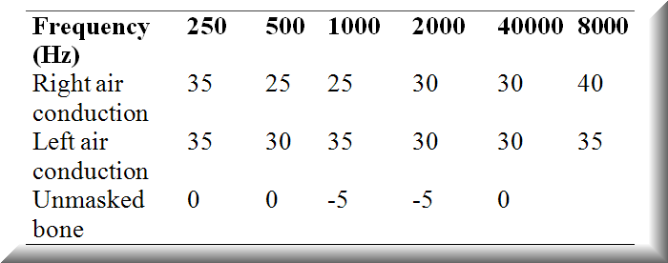

Slide 83
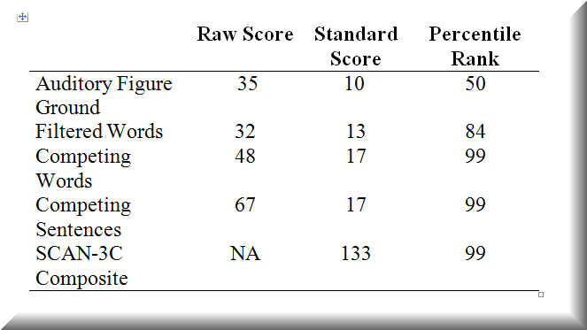
SCAN 3C Results

Slide 84
Results and Recommendations:
Behavioral and electrophysiological measures were within normal limits, and no additional audiological recommendations were made. It was recommended, however, that Mary continue speech-language therapy. If progress is not seen, additional central auditory processing testing in one year is recommended when Mary will be 7 years old. Because of Mary’s predisposition to excessive cerumen accumulation, Mary’s mother was advised to maintain vigilance about cerumen removal with Mary’s pediatrician or ENT.

Slide 85
Hearing Loss
A person with hearing loss can be tested for CAPD; however, tests should be carefully selected and interpretation may still necessarily be qualified or guarded. Distinct patterns of performance on the central auditory test battery can suggest the likelihood of a CAPD, regardless of degree of hearing loss. Moreover, there are low linguistically-loaded tests (e.g., Dichotic Digits Test) or non-speech tests (e.g., Frequency Patterns Test) that are less affected by the presence of a hearing loss. Temporal processing tests (e.g., duration patterns, frequency patterns) may be less influenced by peripheral hearing loss. The Frequency Pattern Test (Musiek & Pinherio, 1987) consists of low frequency tonal stimuli (880 and 1122 Hz) and may be particularly useful if the hearing loss is seen outside these frequencies. Electrophysiologic recordings can be obtained using broadband stimuli, such as clicks, or low frequency tone bursts where normal hearing may be present.

Slide 86
What CAPD risk factors were reported?
History of protracted otitis media, hyperbilirubinemia (jaundice), speech delay, and poor academic performance in reading and spelling

Slide 87
Why would central auditory processing testing be considered at a later age?
CAPD testing is rigorous and places considerable demands on the child for focused attention, physical and mental endurance, and the ability to process challenging tasks. For the most part, normative data for many central auditory processing tests before the age of 7 are not available; moreover, due to the challenge associated with these tasks, normal, young, children present considerable variability in performance. Additional testing may be recommended if Mary does not make progress in speech-language therapy.

Slide 88
Case ‘Clara’ age 14
Dx of ADHD; does not take medication
Dx of ASD
No support Services
Normal peripheral hearing
SCAN: 3A
Raw Score Scaled Score Percentile
Auditory Figure Ground 32 11 63
Filtered Words 35 12 75
Competing Words 54 13 84
Competing Sentences 70 12 75
SCAN Composite NA 115 84

Slide 89
Clara continued..
Three Interval Forced Choice Gaps-In-Noise: 2msec
Frequency Pattern Test: 100% Left ear Verbal
D
ichotic Digits: 100% for right and left ears
Recommendations
?

Slide 90
Case J: 8 yr old male w/ ASD
SCAN: 3C
Raw Score Standard Score Percentile
Filtered Words 36 10 50
Auditory Figure Ground 26 10 50
Competing Words 36 (L=11; R=15) 7 16
Competing Sentences 38 (L=3; R=35) 8 25
SCAN Composite NA 90 25

Slide 91
Case J: 8 yr old male w/ ASD
Dichotic Digits: Right ear 96%; Left Ear: 25%
The Staggard Spondaic Word (SSW) test was also administered. During this test compound words are presented in such a manner to there are quiet and dichotic conditions for the right and left ears. The following scores were obtained.
Condition Errors Norms (2SD)
Right Non-Competing 4 6
Right Competing 20 13
Left Competing 31 19
Left Non-Competing 3 8
Total Errors 58 36

Slide 92
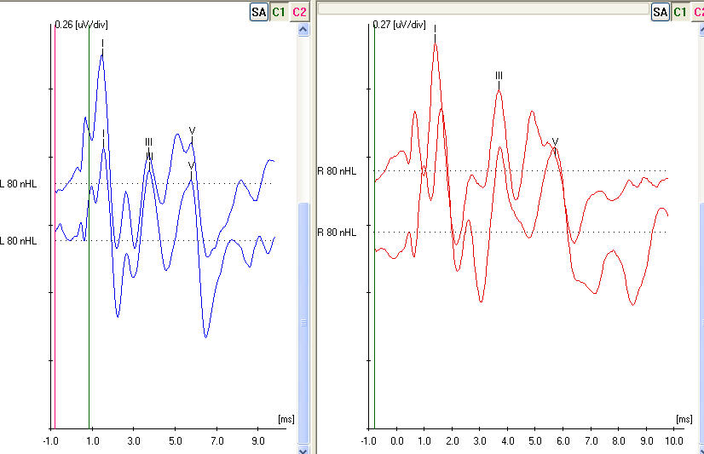

Slide 93
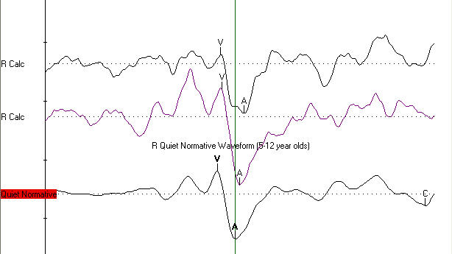

Slide 94

Questions
Thank you! ahurle@lsuhsc.edu

Slide 95
Collaboration Between SLPs and Audiologists
What do you wish the other discipline knew about your role?
Where do scopes overlap or diverge?
Who leads listening goal discussions in your setting?
Encourages interdisciplinary teamwork.

Slide 96
References
Aboitiz, et al. (1992). Fiber composition of human corpus callosum. Brain Res: 598: 143-153
Bomba et al (2004) Cortical auditory evoked potential in autism: a review. Int J Psychophysiolog 53: 161-169.
Booth et al (2011). Connectivity and the corpus callosum in autism spectrum conditions; insights from comparison of autism and callosal agenesis. Prog Brain Res 189: 303-317.
Courchesne et al (1984) Autism: processing of novel auditory information assessed by event related brain potentials Electro Clin Neurophysiology 59: 238-248.
Courchesne et al (1985) Eventr related brain potential correlates of the processing of novel visual and auditory information I autism J Autism Dev Disord 15: 55-75.
Dunn et al(2008). Mismatch negativity in children with autism and typical development. 38: 52-71.
Ferri et al. (2003) The mismatch negativity and the P3a components of the auditory event-related potentials in autistic low functioning subjects. Clin Neurophysiolg 114: 1671-1680.
Gomot et al.(2002)Hypersensitivity to acoustic change in children with autism: electrophysiological evidenceof left frontal cortex dysfunctioning. Psychophysiology 39: 577-584.
Haas et al. (1996). Neurologic abnormalities in infantile autism. J Child Neurol 11: 84-92.
Hardan, et al (2000). Corpus callosum size in autism. Neurology 55: 1033-1036
Hayashi, et al(1989). A neurolinguistic study of autistic children employing dichotic listening. Tokai J Exp Clin Med 14: 339-345.
Kuhl et al (2005). Links between social and linguistic processing of speech in preschool children with autism: behavioral and electrophysiological measures Dev Scie 8: F1-12.
Lau, C.A. (2012). Audiology must take its rightful place on the autism team. Hearing Journal. 65: 18-19.
Maziade, M. et al (2000) Prolongation of brainstem auditory-evoked responses in acoustic probands and their unaffected relatives. Arch Gen Psychiatry 57: 1077-83.
Manes, et al (1999). An MRI study of the corpus callosum and cerebellum in mentally retarded autistic individuals. J. Neurophychiatry Clin Neurosci 11: 470-474.
Musiek, F.E., Baran, J.A., & Shinn, J. 2004. Assessment and remediation of an auditory processing disorder associated with head trauma. J Am Acad Audiol, 15: 117-132.
Niwa, S., Ohta, M., Yamazaki, K. (1983). P300 and stimulus evaluation process in autistic subjects. J Autism Dev Disord 13: 33-42.
Novic et al (1980) An electrophysiologic indication of auditory processing defects in autism. Psychiatry Res 3? 107-114.
Novic et al (1979) An electrophysiologic indication of defective information storage in childhood autism Psychiatry Res 1: 101-108.
Rosenblum, S.M., Arick, J.R., Krug, D.A., Stubbs, E.G., Young, N.B., Pelson, R.O. (1980). Auditory brainstem evoked responses in autistic children. J Autism Dev Disorder 10: 215-225.
Russo et al (2009) Brainstem transcription of speech is disrupted in children with autism spectrum disorder 12: 4, 557-567.
Rosenhall et al (2003). Autism and Auditory Brain Stem Responses Ear and Hearing 24: 206-214.
Russo et al. (2008) Deficient brainstem encoding of pitch in children with autism spectrum disorders. Clinical Neurophysiology. 119: 1720-1731.
Russo et al (2010). Biological changes in auditory function following training in children with autism spectrum disorder. 6: 60.
Taylor, M.J., Rosenblatt, B., Linschoten, L. (1982). Auditory brainstem responses abnormalities in autistic children. Can J Neurol Sci 9: 429-433.
Waiter et al. (2005). Structural white matter deficits in high functioning individuals with autistic spectrum disorder: A voxel based investigation. Neuroimage 24: 455-461.

