Slide 1
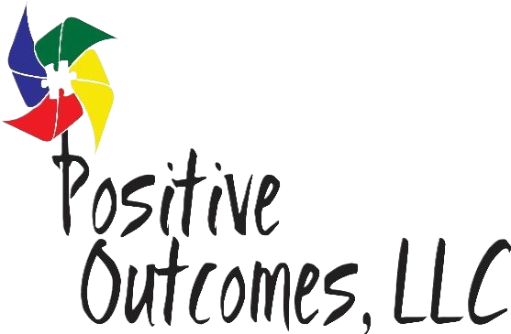

Bridging ABA & Speech
Collaborative Strategies for Autism
presented by
Kimberly Peters, BCBA
Notes:
Credit picture :
Unsplash

Slide 2


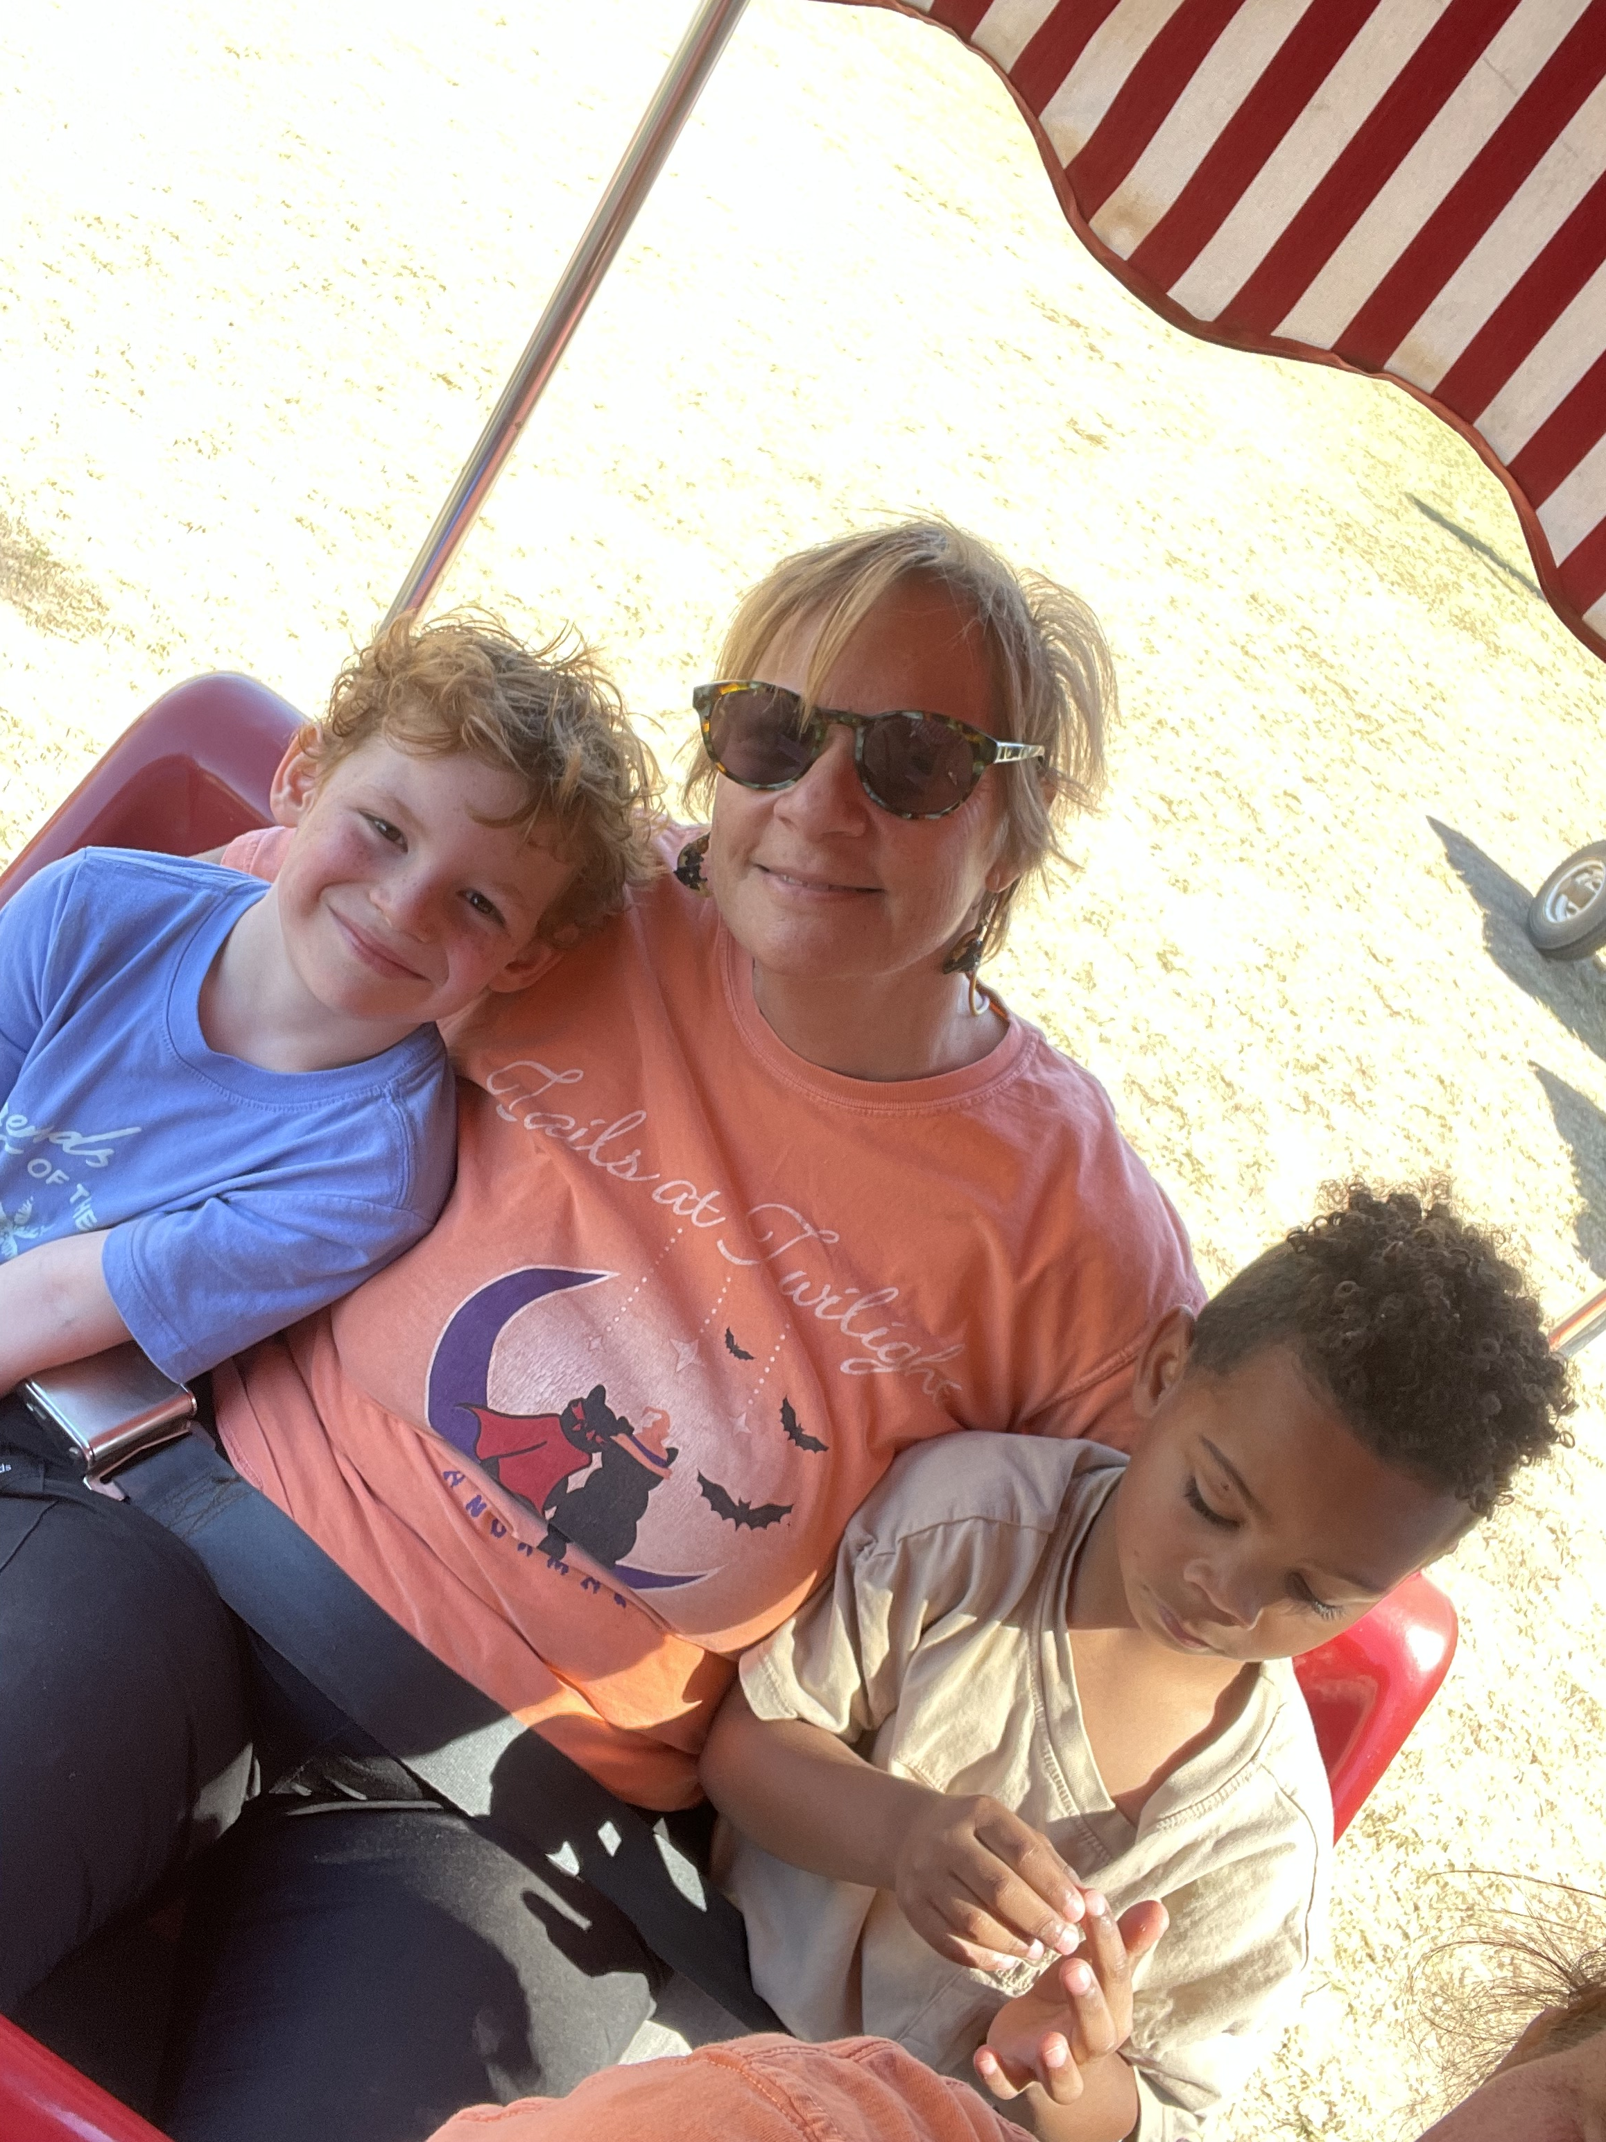
About us
Our Mission:
Positive Outcomes aims to provide the highest level of care, treatment, and guidance for children living with autism spectrum disorder. Our purpose is to bring about meaningful changes in the lives of our clients in meeting and overcoming everyday challenges while also serving as a rich resource for the families we support.
Meet the BCBA
I made a career change to Applied Behavior Analysis (ABA) in 2014 after having worked with various adolescent and adult populations. By the time I encountered them, the time for intervention was largely gone. Their future was somewhat cemented. When given the opportunity to change career focus, I was determined to work with young children and intervene earlier. If a child could have an adult advocate for them or received services early to address skill deficits and/or maladaptive behaviors, the outcome for a successful childhood and adulthood could have been possible. So, on January 1, 2015 I opened Positive Outcomes to focus on children ages 3-13 who may be on the Autism Spectrum but may also have related disorders such as ADHD, developmental delays, ODD, fetal alcohol syndrome, or sensory and language disorders. I also work with the Department of Children and Family Services to help children in the foster care system who may have behaviors that cause foster placement changes or may interfere with the adoption process. Positive Outcomes is my passion. Special needs children often do not get all the services they can and often it is a matter of knowing what services are available. ABA is a relatively new field, and many caregivers are not aware of its ability to address skills deficits and behavioral issues. I welcome the opportunity to do this webinar to educate caregivers and medical staff on what ABA can do to help children have a more successful childhood and adulthood.
Notes:
Credit picture :
Unsplash

Slide 3
What Is Autism?
Autism is a neurodevelopmental condition that affects how individuals communicate, interact, and process information.
• It exists on a spectrum, and every individual’s strengths and challenges look different.
• Common areas impacted: communication, social interaction, sensory processing, and flexibility.
• For SLPs: language goals often need to consider motivation, regulation, and sensory needs, not just articulation.

Slide 4

AUTISM SPECTRUM DISORDER
LEVEL 0: Subclinical
LEVEL 1: Requiring Support
LEVEL 2: Requiring Substantial Support
LEVEL 3: Requiring Very Substantial Support
Traits are present but may not meet full diagnostic criteria.
May struggle with things like social nuance, sensory sensitivities, or executive functioning.
Often develops personal coping strategies and may not require formal support.
Example: A person who experiences social anxiety or sensory overwhelm but manages daily life independently.
Challenges with initiating and maintaining social interactions.
May appear socially awkward or rigid in thinking.
Can manage most daily tasks with minimal support, but may benefit from accommodations (e.g., therapy, structure).
Example: A person who works or attends school independently but struggles in unstructured social situations or with change.
Noticeable communication and behavioral differences.
Difficulty with verbal and nonverbal communication; repetitive behaviors are more pronounced.
Needs structured environments and regular support for success in school, work, or social settings.
Example: A person who may use limited speech, rely on visual supports, and needs help managing daily transitions.
Significant challenges with communication, behavior, and daily living skills.
May be non-speaking or use alternative communication methods.
Intense support needed for safety, regulation, and functioning across most environments.
Example: A person who requires one-on-one support throughout the day for communication, self-care, and learning.
Notes:
Credit picture :
Unsplash

Slide 5
What Is ABA?
Applied Behavior Analysis (ABA) studies why behaviors occur and how to teach meaningful new skills.
• ABA is data-driven and highly individualized.
• In communication, ABA focuses on the function of speech — why a child communicates (requesting, refusing, gaining attention, etc.).
• Collaboration between ABA and Speech ensures both motivation (the WHY) and skill (the HOW) are supported.

Slide 6

Key Principles of ABA
Behavior is learned and can be changed
Focus on measurable behaviors
Use of data-driven decisions
Individualized programs
Reinforcement is key

Slide 7

Addressing Common Misconceptions
ABA forces autistic children to act “neurotypical”
It’s just bribing kids with candy and toys.
ABA only focuses on stopping “bad behaviors”

Slide 8
Why collaboration between ABA & Speech Matters
Speech therapy focuses on language structure, articulation, and communication goals.
ABA focuses on how to teach and motivate learning behaviors.
They essentially “complete each other” and ensure the client is learning effectively.
• ABA helps children learn the 'how'.
• Speech therapy helps children learn the 'what'.
Collaboration ensures skills are both learned and generalized across environments.

Slide 9
Autism and Communication
Autism affects how children communicate, interact, and process information.
Common communication profiles include:
• Nonverbal: Relies on gestures, devices, or other non-spoken methods.
• Minimally verbal: Uses single words or short phrases.
• Echolalia: Repeats words or phrases instead of answering directly.
• AAC (Augmentative and Alternative Communication): Tools such as speech devices or picture systems that help express needs.
• Social communication challenges: Difficulty taking turns, starting conversations, or understanding cues.

Slide 10

Core ABA Strategies That Support Speech Therapy
• Pairing and Building Rapport: Make sessions enjoyable so the child associates learning with positive experiences.
• Prompting Hierarchies: Gradually reduce assistance (physical → visual → verbal → independent).
• Reinforcement: Use meaningful motivators (praise, play, favorite activities).
• Shaping: Break down communication into small, teachable steps.
• Data Collection: Track progress to understand what’s working and adjust teaching methods.
Note: Prompting sequences may move from most-to-least or least-to-most depending on the child’s current skill set and learning history.

Slide 11
Collaborating Effectively
• Align ABA programs with speech goals to create consistency.
• Communicate regularly between teams and share data (within HIPAA guidelines/parental consent)
• Focus on progress, not perfection, celebrate small wins.
• Collaboration isn’t about whose method works best, but what helps the child progress.
• Blend natural play with structured teaching to meet both therapeutic goals.

Slide 12
Scenario 1: Device Refusal
Emma, age 6, is autistic and nonverbal. You encourage her to use her speech device, but she pushes it away
• What ABA strategies could help (pairing the device with preferred items, shaping small steps)?
• How can the SLP and BCBA collaborate to make the device more motivating for Emma?

Slide 13
Scenario 2: Noncompliance with Task
Jayden, age 8, is verbal but limited. During speech drills, he screams and throws materials when asked to respond.
• What might be the function of this behavior (escape, attention)?
• How can ABA’s behavior analysis guide intervention?
• How can the SLP modify the activity to reduce frustration?

Slide 14

Scenario 3: Echolalia
Sophie repeats everything you say instead of answering your questions.
• How can ABA techniques teach functional responses (using fill-in-the-blank, practicing flexible answers)?
• How can SLPs use repetition constructively within therapy?

Slide 15

Scenario 4: Transition Trouble
Liam, age 5, has meltdowns when it’s time to leave speech therapy.
• How can ABA strategies (visual schedules, countdowns, reinforcement) help smooth transitions?
• How can SLPs integrate communication choices into transitions (like saying 'one more minute' or 'all done')?

Slide 16
Joint Planning Activity
Work in small groups to combine ABA and speech goals for a single case.
Example Goal: Teach a child to request a snack using a communication device.
• SLP: Focus on expanding vocabulary and sentence structure.
• ABA: Reinforce all attempts and fade prompts gradually.
Collaboration ensures consistency across sessions and settings.

Slide 17
Wrap-Up & Discussion
Key Takeaways:
• ABA and Speech Therapy complement each other — collaboration enhances outcomes.
• Clear communication between disciplines is vital.
• Every child benefits when professionals work as one team.
Questions & open discussion.

Slide 18

Thank You!
Contact us :
(318) 396-5210 positivebehavioroutcomes@gmail.com
3602 Cypress St. Suite D West Monroe, LA 71291

