Slide 1
Evidenced-Based Vocabulary and Grammar Assessment and Interventions for Elementary Students
Eileen Haebig, PhD, CCC-SLP
Associate Professor
Louisiana State University

Slide 2
Disclosures
Eileen Haebig is a full-time employee as an associate professor at Louisiana State University.
Eileen Haebig has no nonfinancial conflicts of interest to disclose.

Slide 3
Learning Objectives
Attendees will accurately define two vocabulary intervention strategies and generate at least two examples of how the strategies can be implemented into a therapy session.
Attendees will identify morphosyntactic structures to assess and target for intervention and describe at least one intervention strategy to facilitate learning of the morphosyntactic therapy targets.

Slide 4
Additional Learning Objectives
Attendees will identify strategies for selecting vocabulary targets.
Attendees will understand why morphosyntactic markers and clause structure is important even in early elementary and early childhood programs within schools.

Slide 5
Roadmap for today
Review of features of language disorder
Evidence-based assessment approaches
Vocabulary intervention
Practice scoring of morphosyntactic language targets
Grammar intervention

Slide 6
Developmental Language Disorder (DLD)
True or False? https://radld.org/about/dld/dld-quiz/
1 | With support and understanding, individuals with DLD can achieve social, academic, and professional success.
2 | People with DLD can have difficulties learning to read.
3 | DLD is a hidden disability that affects approximately 1 in 14 people.
4 | People with DLD are not intelligent.
5 | A bilingual speaker can have DLD in one language, but not the other.
6 | A child with DLD may also have difficulties with attention, fine and gross motor skills, speech, and behavior.
7 | Adolescents with DLD don’t benefit from speech-language therapy.
8 | Only children from low socio-economic backgrounds have DLD.
9 | The cause of DLD is unknown, but it can run in families.
10 | DLD does not affect adults.

Slide 7


Developmental Language Disorder (DLD)
Sometimes referred to a specific language impairment (SLI)
7% of the population (Tomblin et al., 1997)
  (UK study: 7.5% Norbury et al., 2016)
www.dldandme.org
Notes:
~2 children in each classroom

Slide 8
Language Form: Syntax and Morphology
“A striking diagnostic feature of children with SLI [DLD] is their deficiencies in grammar, including syntactic and morphological deficiencies.”
(Hegde & Maul, 2006 p.65)
Use short, less syntactically complex utterances
(Schuele & Dykes, 2005; Wilder & Redmond, 2021)
Many errors and omissions (‘zero marking’) on grammatical morphemes
(Rice & Wexler, 1996)

Slide 9
Language Form: Syntax and Morphology 2
Tense and Agreement Marking
Verbal –s (third person singular –s) He walks to the store.
Past tense –ed He walked to the store.
Copula BE (is, are, am, was, were) He is tired. They were nice.
Auxiliary BE (is, are, am, was, were) I am sleeping. They are talking.
Auxiliary DO (do, does, did) Do you know? She does not see it.
Some errors in GAE are acceptable in AAE and should be carefully considered in determining DLD
Same ORDER of development as children with typical development
(Oetting & McDonald, 2001; Oetting et al., 2021; Rice & Wexler, 1996)

Slide 10
Language Form: Phonology
40% have phonological problems
Problems with phonology interact with other aspects of language
  Phonological complexity influences early productive vocabulary
  Difficult to produce grammatical morphemes, omitted/zero marked more often
  (Conti-Ramsden & Durkin, 2012; Kaderavek & Henbest, 2024; DiDonato Brumbach & Goffman, 2014)

Slide 11
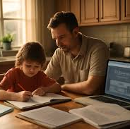
Language Form: Associated Problems
Phonological awareness related to reading skills
  Problems with detecting, segmenting, and blending sounds in words
Many children with DLD have problems learning to read (Adlof, 2020; Catts, 1991)
Problems with nonword repetition (Dollaghan & Campbell, 1998)

Slide 12
Language Content
Late onset of early productive vocabulary
May have restricted, concrete knowledge of words (Sheng & McGregor, 2010)
  Overextend & underextend words – problems with generalization
  More problems naming pictures of common objects & newly learned words
  Difficulty with abstract concepts
  Restricted vocabulary → impacts academics
    Use of indefinite words (e.g., stuff, thing, this)
    Problems with word finding
    (Gray, 2004; Kan & Windsor, 2010; Leonard et al., 2019; McGregor et al., 2013)

Slide 13

Language Use
Use language for same purposes as typical children
Less initiation, more replies
Communication problems may have secondary impact on social skills
(Bishop & Norbury, 2002)

Slide 14
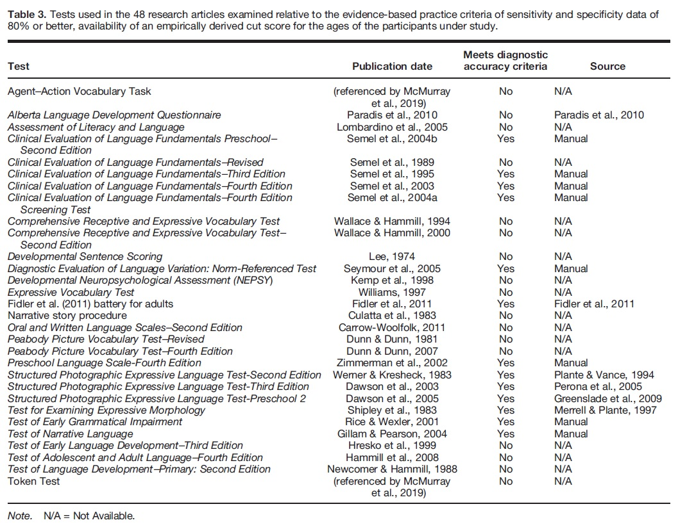
Nitido & Plante (2020) JSLHR
CELF-4 & 5
CELF-P2 & 3
SPELT-P2
SPELT-3
PLS-4 & 5
TEEM
DELV-NR
Test of Narrative Language (TNL)
Test of Early Grammatical Impairment (TEGI)
Fidler et al. (2011) battery for adults
Notes:
Test for Examining Expressive Morphology (TEEM)
Diagnostic Evaluation of Language Variation: Norm-Referenced Test

Slide 15
Nitido & Plante (2020) JSLHR
CELF-4 & 5
CELF-P2 & 3
SPELT-P2
SPELT-3
PLS-4 & 5
TEEM
DELV-NR
Test of Narrative Language (TNL)
Test of Early Grammatical Impairment (TEGI)
Fidler et al. (2011) battery for adults
Notes:
Test for Examining Expressive Morphology (TEEM)
Diagnostic Evaluation of Language Variation: Norm-Referenced Test

Slide 16
Curriculum-Based Language Assessment
Naturalistic assessment process
  Assess academic content and social interaction demands of the curriculum
  Measure the language skills that the students has and consider how that interacts with the curriculum
  Identify instructional modifications that can enhance academic success
(ASHA, 2001)
Notes:
performance.

Slide 17

Language Sample Analysis
Length
  Optimal: 100 complete and intelligible utterances
    Acceptable: 1-, 3-, and 7-minute samples
    (Heilmann, Nockerts, & Miller, 2010, LSHSS)
Tools:
  SALT
  SUGAR
  CLAN
    Using Computer Programs for Language Sample Analysis (Pezold, Imgrund, & Storkel, 2020, LSHSS)

Slide 18

Vocabulary Intervention
Rich Vocabulary Instruction
Retrieval-Based Word Learning

Slide 19
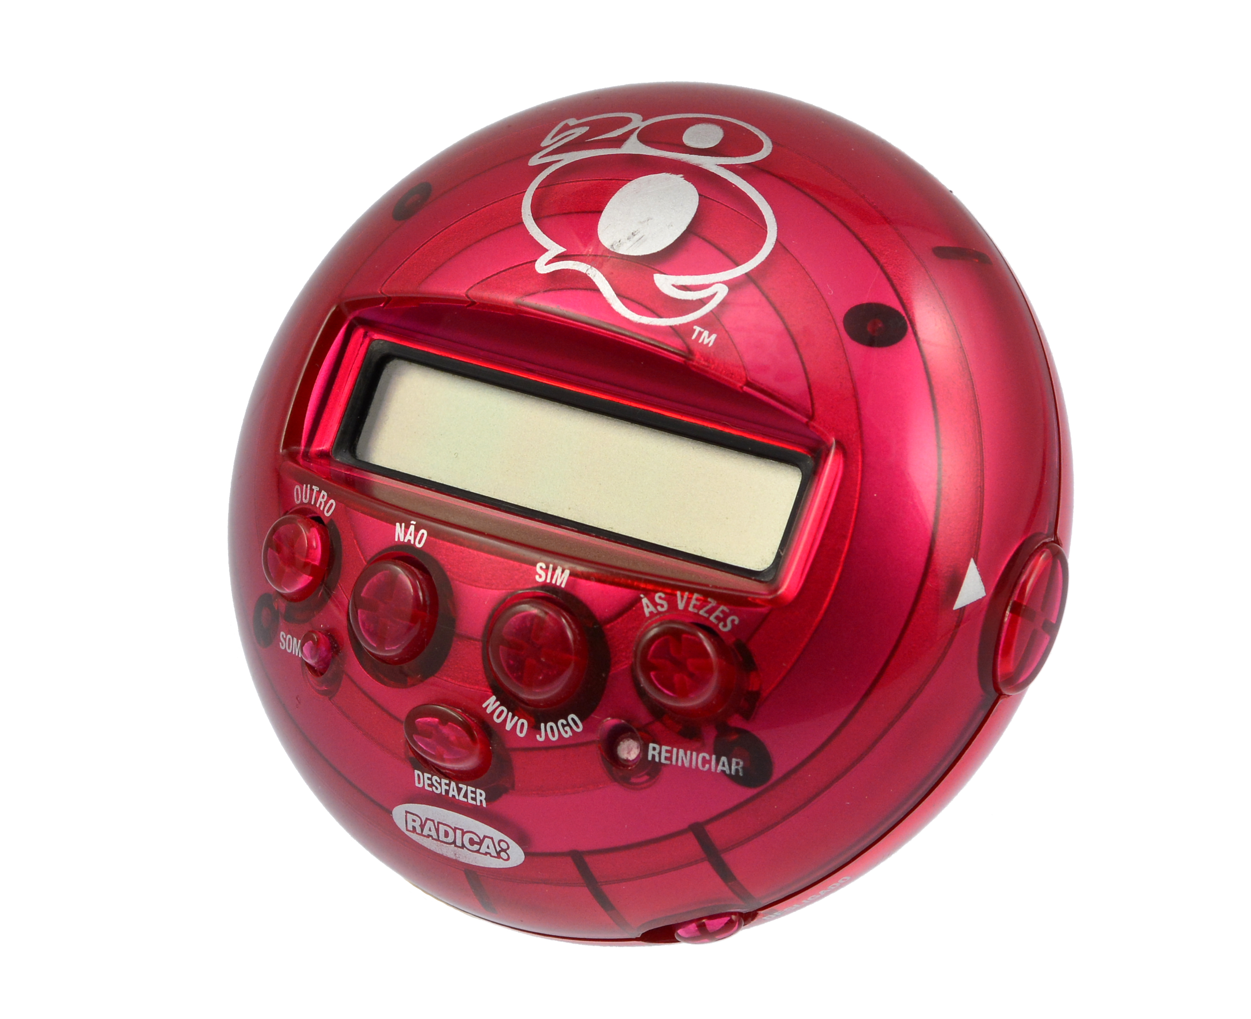
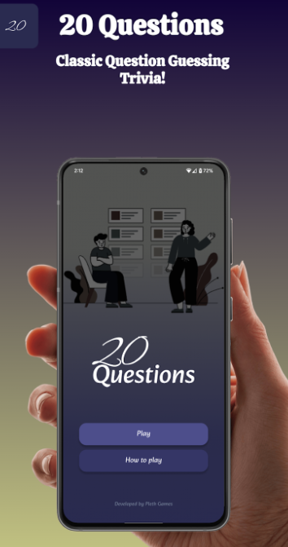
Rich Vocabulary Instruction
Repeated and spaced exposure with new concepts
Exposure is provided within meaningful contexts
Learners are encouraged to deeply process the information via comparison, description, and play
(Beck & McKeown, 2007; Coyne et al., 2009; Maynard et al., 2010; McGregor et al., 2021 )

Slide 20
Robust Evidence-Based Strategy
Principle 10 of Fey, Long, and Finestack (2003)
  Use elicited imitation to make target more salient and to give child practice with targets that are difficult to produce
      Related but different (and even more powerful when spaced/delayed): Repeated Spaced Retrieval Practice

Slide 21
Related Learning Principle: Retrieval Practice
When students are required to recall recently taught information from memory​
There is clear evidence that it is beneficial for increasing learning in a variety of educational domains​
Retrieval-based learning activities can include flashcards, brain dumps, and quizzes
Non-retrieval-based learning activities include rereading texts, hearing summaries of information, and creating concept maps​
(Fazio & Agarwal, 2020; Karpicke et al., 2016)

Slide 22
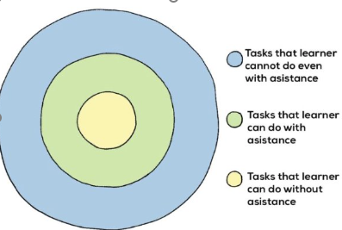
Ways to implement Retrieval-Based Learning
Desirable Difficulties​
  Level of difficulty of recall information​
  Level of spaced retrieval​
Cognitive Processing Language​
  "Deliberate memory demands"​
  “Strategy suggestions"​
  "Requests for students to think about their thinking"​
  Builds problem solving skills​
(Fazio & Agarwal, 2020)

Slide 23
More about spaced retrieval learning
What is Spaced practice?​
  determining a total amount of time to learn something and then spreading it out over a certain number of sessions​
More time spent learning via retrieval does not mean increased retention​
The most important thing is how that time is dispersed​
Beneficial for any type of learning!
(Carpenter & Agarwal, 2020)

Slide 24
WHY DOES SPACED RETRIEVAL WORK?
Spaced Practice
  Information is stored in long term memory and is prompted to be recalled
  More effortful type of retrieval practice
  When the information is retrieved, the person can form an even richer representation of that memory, creating more robust knowledge
Massed Practice (Cramming)
  Information is stored in short term memory
  This type of studying is easier (immediate vs. delayed retrieval)
  Re-reading (no retrieval) can produce a false sense of confidence in knowing the information
  Less robust knowledge acquisition
  (Carpenter & Agarwal, 2020)

Slide 25
benefits from spaced learning
Not just increased memorization but increased understanding which leads to generalization​
Improves critical thinking and application​
More durable and long-lasting retention of information​
Applicable for variety of students
(Carpenter & Agarwal, 2020)

Slide 26
Retrieval Practice – Word Learning Examples
Typically developing children
  Goossens et al. (2014); Haebig et al. (2021); Karpicke et al. (2016)
Preschool and Kindergarten children with language disorders (developmental language disorder; DLD)
  Haebig et al. (2019); Leonard et al. (2019, 2020, 2021, 2022, 2024); Leonard & Deevy (2020); Gordon et al. (2021); Gordon et al. (2025); Levlin et al. (2022)
Children who are Deaf and Hard of Hearing
  Reimer, Grantham, & Butler (2024)
Children with Down syndrome
  Starling et al. (2019); Boundy Croft, & Burgoyne (2025)

Slide 27
Retrieval Practice Resources
Here is a great website about retrieval practice: https://www.retrievalpractice.org/library

Slide 28
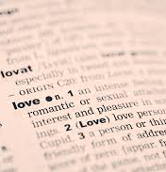
Targets for Vocabulary Goals
Tier 2 words
  Frequent and applicable across domains
    Introduce, compare
  General academic words in the Common Core State Standards
Tier 1 words
  common in input, often learned without direct instruction (i.e., happy, run, pencil)
Tier 3 words
  Rare and limited functional value
    isotope

Slide 29

Dose
Dose: number of learning episodes in a session
Word Learning (Gray, 2003)
  Kindergarten – interactive book reading – 36 exposures (Storkel et al., 2017, 2019)
Grammar
  0.7 – 1.4 conversational recasts per minute (Proctor-Williams, 2009)

Slide 30
Tense and Agreement
Gradual Morphosyntactic Learning Account
(Rispoli, Hadley, & Holt, 2012)
  T/A morphemes do not emerge and develop simultaneously
    Early: COPULA BE
    Late: AUXILIARY BE

Slide 31
Finite Verb Morphology Composite (FVMC)
# appropriate productions of T/A markers
Total # of obligatory contexts for T/A markers
= FVMC score (%)
  Copula is, are, am, was, were
  Auxiliary is, are, am, was, were
  Third person singular –s
  Past tense –ed (overregularized past tense forms were also credited)
      -Irregular past tense forms are not credited.
    Auxiliary do, does, did - This is typically not included in FVMC. It was only included in Gladfelter & Leonard (2013) to facilitate comparisons with TMT and TAP.

Slide 32
Finite Verb Morphology Composite (FVMC)
Highlights accuracy
Drawbacks?
Test of Early Grammatical Impairment (TEGI; Rice & Wexler, 2001)
https://kuscholarworks.ku.edu/handle/1808/32569

Slide 33
Tens & Agreement Productivity Score (TAP)
(Hadley & Holt, 2006; Hadley & Short, 2005)
Productivity
Reflects the productivity of T/A morpheme use
Up to 5 different uses of the morpheme (of the 5 T/A morpheme categories)
  Copula BE (is, are, am, was, were)
  Auxiliary BE (is, are, am, was, were)
  Auxiliary DO (do, does, did)
  Third person singular –s
  Past tense –ed (overregularized past tense forms were also credited)
      -Irregular past tense forms are not credited.

Slide 34
Tens & Agreement Productivity Score (TAP)
(Hadley & Holt, 2006; Hadley & Short, 2005)
Only uncontracted forms (or forms contracted to lexical NPs) can receive credit.
  Examples of what would not receive credit: It’s red. Here’s a cup. They’re coloring.
  Examples of what would receive credit: It is red. Here is a cup. They are coloring.
    The dog’s hungry.
Also Exclude:
  negative sentences containing don’t
  wh-questions with a contracted T/A morpheme (e.g., Where’d it go? What’s that?)
  In contrast, you can credit uncontracted forms: Where did it go? What is that?

Slide 35
Tens & Agreement Productivity Score (TAP)
(Hadley & Holt, 2006; Hadley & Short, 2005)
Distinct uses can take several different forms
  Same morpheme used with different subjects (Mom’s eating. The boy’s riding a bike.)
  Different morphemes (The dogs are barking. He was looking at the book.)
  Inflection category (past tense –ed, 3S) → inflection with different verbs
A TAP captures individual differences between children who might have demonstrated limited emergence or initial productivity for most morphemes from those with fully productive systems.
Maximum score: 25
  The highest score indicates that a child has a full or strong productivity for the system

Slide 36
Tense Marker Total (TMT) (Hadley & Holt, 2006; Hadley & Short, 2005)
A point for using each of the 15 T/A morphemes
  Copula is, are, am, was, were
  Auxiliary is, are, am, was, were
  Auxiliary do, does, did
  Third person singular –s
  Past tense –ed (overregularized past tense forms were also credited)
    Irregular past tense verbs are not credited as Past Tense –ED.
Diversity measure

Slide 37
Tense Marker Total (TMT) (Hadley & Holt, 2006; Hadley & Short, 2005)
All copula and auxiliary forms are required to be uncontracted or contracted to nominal forms.
Only uncontracted forms (or forms contracted to lexical NPs) can receive credit.
  Examples of what would not receive credit: It’s red. Here’s a cup. They’re coloring.
  Examples of what would receive credit: It is red. Here is a cup. They are coloring.
Also Exclude:
  negative sentences containing don’t
  wh-questions with a contracted T/A morpheme (e.g., Where’d it go? What’s that?)
  In contrast, you can credit uncontracted forms: Where did it go? What is that?

Slide 38
Tense Marker Total (TMT) (Hadley & Holt, 2006; Hadley & Short, 2005)
Diversity measure
Range of TMT: 0 - 15

Slide 39
Background on the TAP and TMT scores
Hadley, P., & Short, H. (2005). The onset of tense marking in children at risk for specific language impairment. Journal of Speech, Language, and Hearing Research, 48, 1344-1362.

Slide 40
Hadley & Short (2005)
What patterns of emergence and productivity are evident during the onset of tense marking?
  Low Average
    First: Copula be
    Second: 3s
    Last: auxiliary be
  SLI-at-risk
    First: Copula be Just later
    Second: 3s
    Last: auxiliary be

Slide 41
Hadley & Short (2005)
  30 months
    T/A > MLU
    Copula is differentiated the groups
  36 months Emergence of the full T/A system (5 T/A types – Tense Type Total)
    Differentiates groups
  Are measures of onset and mastery of tense marking related at age 3?
  Measures of mastery yielded overlapping distributions, indicating that mastery is less useful for diagnostic purposes compared to onset measures at age 3
    TAP most strongly associated with a child’s progression towards mastery of T/A marking
    When is mastery of T/A marking a robust clinical marker of SLI/DLD?

Slide 42
Hadley & Short (2005)
Do measures reflecting the onset of tense marking differentiate children at risk for SLI/DLD from low average language learners?
Yes!
TAP was the best measure that predicted language abilities at 36 months of age.
TAP > MLU

Slide 43
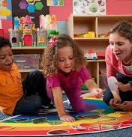
Hadley & Short (2005)
Measures of breadth (TMT) and depth (TAP) are best interpreted together
Clinical application scenarios:
Some concerns of T/A marking that seem to lag behind norms; however, there is clear onset of T/A marking and other language progression is considered age-appropriate.
  Level of concern?
Protracted onset of T/A markers, but age-appropriate vocabulary and MLU
  Level of concern?

Slide 44
Gladfelter & Leonard 2013
How do FVMC, TAP, and TMT scores compare in diagnostic accuracy of children with SLI/DLD between 4 and 5 years of age?
FVMC
  At both ages, the children with SLI had significantly lower FVMC scores relative to their TD peers
SLI/DLD cut-off score = 0.84 (4;0 to 4;6) & 0.85 (5;0 to 5;6)
Young Old
Group classification: sensitivity = 100% & 92.31% (DLD/SLI group) specificity = 100% & 93.33% (TD group)

Slide 45
Gladfelter & Leonard 2013
How do FVMC, TAP, and TMT scores compare in diagnostic accuracy of children with SLI/DLD between 4 and 5 years of age?
TMT
  At both ages, the children with SLI had significantly lower TMT scores relative to their TD peers
SLI/DLD cut-off score = 7 (4;0 to 4;6) & 8 (5;0 to 5;6)
Young Old
Group classification: sensitivity = 83.33% & 76.92% (DLD/SLI group) specificity = 85.19% & 80.00% (TD group)

Slide 46
Gladfelter & Leonard 2013
How do FVMC, TAP, and TMT scores compare in diagnostic accuracy of children with SLI/DLD between 4 and 5 years of age?
TAP
  At both ages, the children with SLI had significantly lower TAP relative to their TD peers
SLI/DLD cut-off score = 12 (4;0 to 4;6) & 16 (5;0 to 5;6)
Young Old
Group classification: sensitivity = 66.67% & 84.62% (DL/SLI group) specificity = 86.67% & 80.00% (TD group)

Slide 47
Caveat About FVMC
Rudolf, J., Dollaghan, C. A., & Crotteaua, S. (2019). The finite verb morphology composite: Values from a community sample. Journal of Speech, Language, and Hearing Research, 62, 1813-1822.
  larger and more representative sample of the population

Slide 48
How can you use TMT, FVMC, and TAP to inform your therapy goals?
High FVMC, but low TMT and TAP
  Intervention activities might focus on introducing T/A morphemes not yet used by the child.
For a child with Finite Verb Morphology Composite and Productivity Scores well below the cutoff, efforts might be directed toward increasing the number of different verbs used with each T/A inflection or the number of different subjects used with each copula or auxiliary form.

Slide 49
Let’s Practice FVMC
Practice items:
The boy running fast.
I see him!
Where Rana going?
He stole my sandwich.
Mommy like eat sardines.
He jumped on me!
Mario wants an apple.
FVMC =_____

Slide 50
Let’s Practice FVMC
Practice items:
The boy running fast 0/1 zero-marked auxiliary is
I see him! 0/0
Where Rana going? 0/1 zero-marked auxiliary is
He stole my sandwich. 0/0
Mommy like eat sardines. 0/1 zero-marked 3S
He jumped on me! 1/1 overtly marked past tense -ed
Mario wants an apple. 1/1 overtly marked 3S
FVM = 2/5 = 40%

Slide 51
Let’s Practice TMT and TAP
Maybe it goes with this zoo?
He’s crying.
Here’s another man that works at the zoo.
What does this guy do?
Is that how it go?
But what is this for?
The popcorn bouncing!
What are these for?
I runned fast.
Daddy’s a Red Sox fan.
So water’s going down.
Where’s the car?
The dog are big.

Slide 52
Let’s Practice TMT and TAP
Maybe it goes with this zoo? 1/1 overtly marked third person singular -s
He’s crying. 0/0 Do not count contracted auxiliary be with a pronoun
Here’s another man that works at the zoo. 1/1 overtly marked third person singular –s
  (do not count contracted copula be in “Here’s”)
What does this guy do? 1/1 overtly marked auxiliary do (“does” in this sentence)
“do” is an untensed main verb in this example
Is that how it go? 1/2 overtly marked copula be, zero-marked third person singular -s
But what is this for? 1/1 overtly marked copula be
The popcorn bouncing! 0/1 zero-marked auxiliary be
What are these for? 1/1 overtly marked copula be
I runned fast. 1/1 overtly marked past tense -ed (overregularized though)
Daddy’s a Red Sox fan. 1/1 overtly marked copula be
So water’s going down. 1/1 overtly marked auxiliary be
Where’s the car? 0/0 Do not count contracted copula be with a wh-question
The dog are big. 0/1 copula be (tense is marked, but there is a form choice error)

Slide 53
Let’s Practice TMT and TAP
TAP | 3S | PT –ed | Aux. Do | Cop. BE | Aux. BE | Total
Instance 1 | goes | runned | does | Is that how it | water’s | 9
Instance 2 | works |  |  | what is
Instance 3 |  |  |  | what are
Instance 4 |  |  |  | Daddy’s
Instance 5
3S | PT-ed | Auxiliary DO |  |  | Copula BE |  |  |  |  | Auxiliary BE |  |  |  |  | Total
- | - | do | does | did | is | am | are | was | were | is | am | are | was | were | TMT
X | X |  | X |  | X |  | X |  |  | X |  |  |  |  | 6

Slide 54
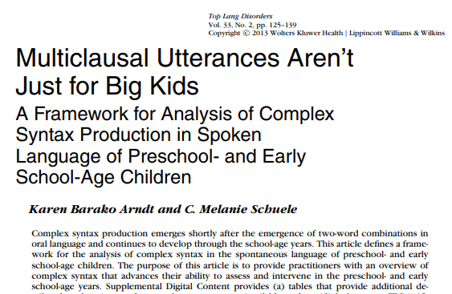
Complex Syntax
Children with DLD struggle to produce and understand complex syntax (e.g., Cahill et al., 2020; Steel et al., 2016).
Persistent challenges with complex syntax can have adverse effects on children’s reading comprehension as well as their academic achievement (Scott & Balthazar, 2013).

Slide 55
Early Developing Complex Sentence Types
Early Development (MLU/M = 3-4) | Examples
Simple infinitive: The word to is used. However, the subject is deleted because it is the same as the main sentence. Does not include catenative forms of infinitive (wanna, gonna, etc.) | • She has to go. • The dog wants to run.
Full propositional complement: Cognitive verbs are used (think, said, guess, know, wonder, hope). | • She thought the room looked messy. • Guess how many I have.
Simple wh-clause: Includes a wh- conjunction: what, where, when, why, who, how. Does not include an infinitive to. | • Why did you say that? • See how he throws that ball?
Simple conjoining: Two clauses joined by a coordinating conjunction (and, but, so, etc.) or subordinating conjunction (because, after, etc.). | • The boy likes to eat lunch early so that he avoids the crowd. (subordinating conj.) • I ate dinner late and I’m tired.

Slide 56
Late Developing Complex Sentence Types
Late Development (MLU/M = 4-5) | Examples
Infinitive clause with different subjects. | • He realized she wouldn’t want to wait any longer. • The boat sailed next to the boy who wasn’t able to swim.
Relative clauses: A subordinate clause that acts as an adjective; may or may not include who, which, or that. | • That’s the ice cream that I tasted. • The argument that they had was silly.
Gerunds: An ing form that is used as a noun. | • Reading is my favorite hobby. • She likes swimming in the outdoor pool.
Wh-infinitives: Use of to, along with wh- conjunctions. | • She doesn’t know how to do it. • I thought you knew what to say.

Slide 57
Late Developing Complex Sentence Types
Late Development (MLU/M = 4-5) | Examples
Conditional Adverbial Clause: a dependent clause that communicates a condition. | If you are tired, you should rest.
Causal Adverbial Clause: a dependent clause that communicates the cause or reason for an action. | I went to bed because I was tired. Since I was confused, I emailed the TA.
Complement Clause: A dependent clasuse ing form that is used as a noun. | That • He thinks that Rasheena has a car. • The dad noticed that the cookies were missing. Wh • I am wondering what the class will be like. • Pradeep wants to know where his phone is.

Slide 58
Language Sample Analysis Multicultural Considerations
Code each utterance as a simple C-unit or a complex C-unit
  Simple C-units:
    “They ∅ talking” “Him be running.” “I have two ball∅.”
  Complex C-units:
    Simple infinitives: “He was tryn’ to get out.”
    Noun phrase complements “I think this is nice.” “I think he be lying”
    Gerunds: “They heard singing.”
  Bilingual children
    Assess using MLU in words instead of MLU in morphemes for older children
    (Kaderavek & Henbest, 2024; Overton et al., 2021; Rice et al., 2010)

Slide 59
Why should we consider targeting complex syntax with school-aged children?

Slide 60
Complex Syntax Goal
Jamice will spontaneously produce sentences with a complement clause in written or spoken form following a teacher or clinician prompt with minimal cueing with 80% accuracy.
Complex syntax (Curran, 2020; Wang et al., 2024)
  Example: Complement clauses
    that complement clause:
      “He thinks that Mary has the key”
    WH complement clause:
      “Mary wants to know where the dog was”

Slide 61
Therapy Strategies
Initial modeling
Explicit teaching
Structured drills or prompted imitations
Naturalistic/embedded learning
(Fey et al., 1993; Finestack et al., 2024)

Slide 62

Intervention Approaches for Clause Density
Sentence Combining
Improves ability to use complex grammar
Shows how words can be put into varying patterns
  Use of coordinating conjunctions and subordinating conjunctions
Appropriate for school-age to college students
Improves writing skills (sometimes; see Walter et al., 2021)
(Kaderavek & Henbest, 2024; Saddler & Graham, 2005; Scott & Nelson, 2009)

Slide 63
Intervention Approaches for SLI/DLD 2
Sentence Combining
Open combining
  Student freely experiments on ways to combine sentences
Sentence Expansion
  An adult provides the child with a kernel sentence and then prompts the child to elaborate the sentence
    Kernel: The boy is tired. Now expand that sentence and tell me why he is tired.
    (Kaderavek & Hebeset, 2024; Saddler et al., 2018)

Slide 64
Intervention Approaches for SLI/DLD 3
Sentence Combining
Simple 1: The boy is running fast.
Simple 2: The boy wears a red hat.
Simple 3: The boy finished the race first.
Complex 1: The boy who is wearing a red hat is running fast and finished the race in first place.
Complex 2: Because the boy with the red hat is running fast, he finished the race in first place.

Slide 65
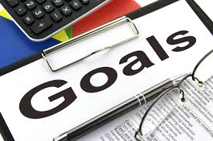
Tense and Agreement Marking Sample Therapy Goal
Gavin will spontaneously produce the copula BE in yes-no questions to obtain information in obligatory contexts >= 50% of the time in a naturalistic 30-minute interaction.
    (e.g., Is the baby happy?”)
    Preintervention baseline on (date) was 10%.

Slide 66
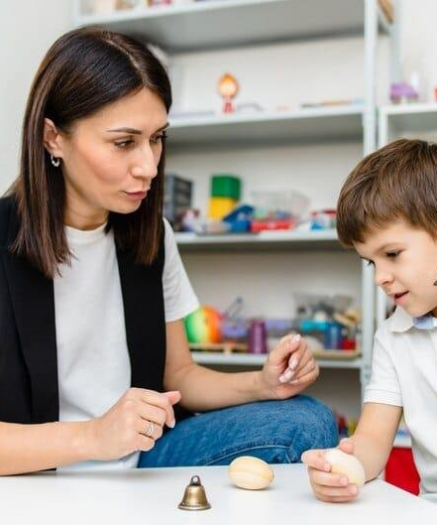
Systematically contrast forms used by child with adult forms by using recasts
Recasts (conversational recasting)
  Based on child’s production
  Easy for child to understand
  Limited memory so more likely to notice your change
  Child is ready to learn because he/she is using context of form
Example
  Child = He go to school everyday.
  Clinician = Yes, he goes to school everyday.
  (Fey, Long, & Finestack, 2003)

Slide 67
Enhanced Conversational Recasting (ECR)
Definition:
Technique where an adult recasts a child's grammatical errors into correct forms while keeping the original meaning.
Provides implicit grammatical feedback in natural conversations.
How It Works:
Child: "He go to school."
Adult (Recast): "Yes, he goes to school."
Child: "I goed home."
Adult (Recast): "Oh, you went home?"
Research Support:
Cleave et al. (2015) – Meta-analysis found ECR significantly improves grammatical development in children with language impairments.
Key finding: Conversational recasts are a highly effective, evidence-based intervention for children with DLD/SLI.
Why It’s Effective:
Natural learning – No forced repetition or direct correction.
Implicit feedback – Models correct grammar within conversation.
High-frequency exposure – Helps reinforce grammatical structures.

Slide 68
High Degree of Linguistic Variability
Exposure to a wide range of unique verbs enhances grammatical generalization.
Using different words in the same grammatical structure supports flexibility.
High-variability input leads to greater grammatical learning
(Plante et al., 2014; Hall & Plante, 2020; Choi-Tucci et al., 2025)
Example: Instead of only practicing "He jumped", introduce variations like "She climbed," "They played," "The dog barked."

Slide 69
Variability of Input
Exposure to varied linguistic input (e.g., different speakers, sentence structures, and lexical items) enhances the ability to generalize grammatical rules.
Example: Instead of using a single sentence frame ("She is jumping."), a child should hear diverse examples:
  "The boy is running."
  "They are playing."
  "The cat is sleeping."
Supporting Research: Gómez (2002) found that greater variability in input forces learners to focus on stable grammatical rules rather than memorizing specific phrases
See also: Plante et al., 2014; Hall & Plante, 2020; Choi-Tucci et al., 2025

Slide 70
Dose
Dose: number of learning episodes in a session
Grammar
  0.7 – 1.4 conversational recasts per minute (Proctor-Williams, 2009)

Slide 71
Other Syntactic Intervention Approaches
Balthazar, C. H., Ebbels, S., & Zwitserlood, R. (2020). Explicit grammatical intervention for developmental language disorder: Three approaches. Language, Speech, and Hearing Services in Schools, 51(2), 226-246.
  Mata Taal (Zwitserlood, 2015; Switserlood, Winjenen, et al., 2015)
  SHAPE CODINGTM (Ebbels, 2007; Ebbels et al., 2014)
  Complex Sentence Intervention (Balthazar & Scott, 2017; 2018)

Slide 72

Meta Taal

Slide 73
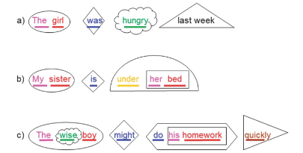
Shape Coding

Slide 74
  Complex Sentence Intervention
  (Balthazar & Scott, 2017; 2018)
Explicit descriptions of the target
Guided practice in identifying and manipulating clauses
  Sentence repetition
  Reading aloud
  Sentence identification
  Sentence deconstruction
  Sentence combining
  Sentence generation
  Preference production
  Cloze production

Slide 75
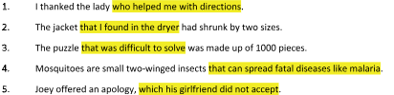
  Complex Sentence Intervention
  (Balthazar & Scott, 2017; 2018)
Explicit descriptions of the target
Guided practice in identifying and manipulating clauses
  Sentence repetition
  Reading aloud
  Sentence identification
  Sentence deconstruction
  Sentence combining
  Sentence generation
  Preference production
  Cloze production

Slide 76
  Complex Sentence Intervention
  (Balthazar & Scott, 2017; 2018)
Explicit descriptions of the target
Guided practice in identifying and manipulating clauses
  Sentence repetition
  Reading aloud
  Sentence identification
  Sentence deconstruction
  Sentence combining
  Sentence generation
  Preference production
  Cloze production
My family belongs to the pool that has many slides.
Main clause: My family belongs to the pool.
Relative clause: The pool has many slides.

Slide 77
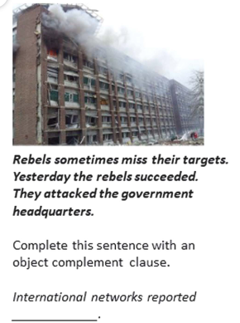
  Complex Sentence Intervention
  (Balthazar & Scott, 2017; 2018)
Explicit descriptions of the target
Guided practice in identifying and manipulating clauses
  Sentence repetition
  Reading aloud
  Sentence identification
  Sentence deconstruction
  Sentence combining
  Sentence generation
  Preference production
  Cloze production

Slide 78
Pulling Information Together
Children with developmental language disorder (and children with language disorder with other co-occurring neurodevelopmental disorders) struggle to learn new words and learn morphosyntax.
There are evidence-based assessments that can help us identify weaknesses that can be combined with naturalistic assessments (e.g., language sample).
  Language samples are ideal for identifying specific therapy targets.
Evidence-based interventions typically include explicit instruction combined with guided practice.

Slide 79
Thank you!
Eileen Haebig, PhD, CCC-SLP
  ehaebig1@lsu.edu

